Slide 1
CSE 301
Microprocessors
Dr. Md. Sujan Ali
Associate Professor
Dept. of Computer Science and Engineering
Jatiya Kabi Kazi Nazrul Islam University
Trishal, Mymensingh, Bangladesh

Slide 2
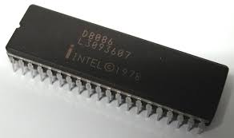
Intel 8086/8088 Microprocessors

Slide 3
Intel 8086 microprocessor
The 8086, announced in 1978, was the first 16-bit microprocessor introduced by Intel Corporation.
8086 is 16-bit microprocessor.
8086 has a 20 bit address bus can access upto 2²⁰ memory locations ( 1 MB).
Externally the 8086 has a 16-bit data bus 8086 has the ability to address up to 1 Mbyte of memory and 64K of input/output port.
The 8086 is manufactured using high-performance metal-oxide semiconductor (HMOS) technology.
The 8086 is housed in a 40-pin dual inline package and many pins have multiple functions.

Slide 4
Internal architecture of 8086 (cont’d)
Figure:
Block Diagram of 8086

Slide 5
Internal architecture of 8086 (cont’d)
The architecture of 8086 includes
  Arithmetic Logic Unit (ALU)
  Flags
  General registers
  Instruction byte queue
  Segment registers

Slide 6
Internal architecture of 8086 (cont’d)
The 8086 CPU is divided into two independent functional units:
Bus Interface Unit (BIU)
The BIU has to interact with memory and input and output devices in fetching the instructions and data required by the EU
Execution Unit (EU)
EU is responsible for executing the instructions of the programs and to carry out the required processing

Slide 7
Internal architecture of 8086 (cont’d)
Bus Interface Unit (BIU)
The BIU has
  Instruction stream byte queue
  A set of segment registers
  Instruction pointer

Slide 8
Internal architecture of 8086 (cont’d)
BIU – Instruction Byte Queue
8086 instructions vary from 1 to 6 bytes
Therefore fetch and execution are taking place concurrently in order to improve the performance of the microprocessor
The BIU feeds the instruction stream to the execution unit through a 6 byte prefetch queue
This prefetch queue can be considered as a form of loosely coupled pipelining

Slide 9
Internal architecture of 8086 (cont’d)
BIU – Instruction Byte Queue
Execution and decoding of certain instructions do not require the use of buses
While such instructions are executed, the BIU fetches up to six instruction bytes for the following instructions (the subsequent instructions)
The BIU store these prefetched bytes in a first-in-first out register by name instruction byte queue
When the EU is ready for its next instruction, it simply reads the instruction byte(s) for the instruction from the queue in BIU

Slide 10
Internal architecture of 8086 (cont’d)
Segment Registers (cont’d)
The memory of 8086 is divided into 4 segments namely
  Code segment (program memory)
  Data segment (data memory)
  Stack memory (stack segment)
  Extra memory (extra segment)

Slide 11
Internal architecture of 8086 (cont’d)
Segment Registers (cont’d)
Code Segment (CS) register
It is a 16-bit register containing address of 64 KB segment with processor instructions
The processor uses CS segment for all accesses to instructions referenced by instruction pointer (IP) register
It points to the starting address of the code segment

Slide 12
Internal architecture of 8086 (cont’d)
Segment Registers (cont’d)
Stack Segment (SS) register
It is a 16-bit register containing address of 64KB segment with program stack
By default, the processor assumes that all data referenced by the stack pointer (SP) and base pointer (BP) registers is located in the stack segment
It is used to compute the address of the stack location to be accessed.

Slide 13
Internal architecture of 8086 (cont’d)
Segment Registers (cont’d)
Data Segment (DS) register
It is a 16-bit register containing address of 64KB segment with program data
By default, the processor assumes that all data referenced by general registers (AX, BX, CX, DX) and index register (SI, DI) is located in the data segment
It points to the starting address of the data segment. The maximum capacity of a segment may be up to 64Kbytes. The starting address is divisible by 16.

Slide 14
Internal architecture of 8086 (cont’d)
Segment Registers
Extra Segment (ES) register
It is a 16-bit register containing address of 64KB segment, usually with program data
By default, the processor assumes that the DI register references the ES segment in string manipulation instructions

Slide 15
Internal architecture of 8086 (cont’d)
Instruction pointer
It points to the address of the next instruction to be executed.

Slide 16
Internal architecture of 8086 (cont’d)
Execution Unit (EU) (cont’d)
The Execution Unit (EU) has
  Control unit
  Instruction decoder
  Arithmetic and Logical Unit (ALU)
  General registers
  Flag register
  Pointers
  Index registers

Slide 17
Internal architecture of 8086 (cont’d)
Execution Unit (EU) (cont’d)
Control unit is responsible for the co-ordination (control) of all other units of the processor
ALU performs various arithmetic and logical operations over the data
The instruction decoder translates the instructions fetched from the memory into a series of actions that are carried out by the EU

Slide 18
Internal architecture of 8086 (cont’d)
Execution Unit – Registers (cont’d)

Slide 19
Internal architecture of 8086 (cont’d)
Execution Unit – Registers (cont’d)
General registers are used for temporary storage and manipulation of data and instructions
Accumulator register consists of two 8-bit registers AL and AH, which can be combined together and used as a 16-bit register AX
Accumulator can be used for I/O operations and string manipulation

Slide 20
Internal architecture of 8086 (cont’d)
Execution Unit – Registers (cont’d)
Base register consists of two 8-bit registers BL and BH, which can be combined together and used as a 16-bit register BX
BX register usually contains a data pointer used for based, based indexed or register indirect addressing
Count register consists of two 8-bit registers CL and CH, which can be combined together and used as a 16-bit register CX
Count register can be used as a counter in string manipulation and shift/rotate instructions

Slide 21
Internal architecture of 8086 (cont’d)
Execution Unit – Registers (cont’d)
Data register consists of two 8-bit registers DL and DH, which can be combined together and used as a 16-bit register DX
Data register can be used as a port number in I/O operations
In integer 32-bit multiply and divide instruction the DX register contains high-order word of the initial or resulting number

Slide 22
Internal architecture of 8086 (cont’d)
Execution Unit – Registers
Base register consists of two 8-bit registers BL and BH, which can be combined together and used as a 16-bit register BX
BX register usually contains a data pointer used for based, based indexed or register indirect addressing
Count register consists of two 8-bit registers CL and CH, which can be combined together and used as a 16-bit register CX
Count register can be used as a counter in string manipulation and shift/rotate instructions

Slide 23
Internal architecture of 8086 (cont’d)
Execution Unit – Functions
The functions of execution unit are:
To tell BIU where to fetch the instructions or data from.
To decode the instructions.
To execute the instructions.
The EU contains the control circuitry to perform various internal operations.
A decoder in EU decodes the instruction fetched memory to generate different internal or external control signals required to perform the operation.
EU has 16-bit ALU, which can perform arithmetic and logical operations on 8-bit as well as 16-bit.

Slide 24
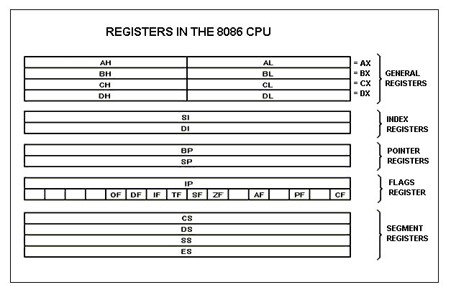
Register structure of 8086 (cont’d)

Slide 25
Register structure of 8086 (cont’d)
General purpose registers (cont’d)
8086 CPU has 8 general purpose registers
AX - the accumulator register (divided into AH / AL):
  Generates shortest machine code
  Arithmetic, logic and data transfer
  One number must be in AL or AX
  Multiplication & Division
  Input & Output
BX - the base address register (divided into BH / BL).

Slide 26
Register structure of 8086 (cont’d)
General purpose registers (cont’d)
CX - the count register (divided into CH / CL)
  Iterative code segments using the LOOP instruction
  Repetitive operations on strings with the REP command
  Count (in CL) of bits to shift and rotate
DX - the data register (divided into DH / DL):
  DX:AX concatenated into 32-bit register for some MUL and DIV operations
  Specifying ports in some IN and OUT operations

Slide 27
Register structure of 8086 (cont’d)
General purpose registers (cont’d)
SI - source index register:
  Can be used for pointer addressing of data
  Used as source in some string processing instructions
  Offset address relative to DS
DI - destination index register:
  Can be used for pointer addressing of data
  Used as destination in some string processing instructions
  Offset address relative to ES

Slide 28
Register structure of 8086 (cont’d)
General purpose registers (cont’d)
BP - base pointer:
  Primarily used to access parameters passed via the stack
  Offset address relative to SS
SP - stack pointer:
  Always points to top item on the stack
  Offset address relative to SS
  Always points to word (byte at even address)
  An empty stack will had SP = FFFEh

Slide 29
Register structure of 8086 (cont’d)
Segment Register
[N.B. Please see BIU]

Slide 30
Register structure of 8086 (cont’d)
Special purpose registers (cont’d)
IP - the instruction pointer:
  Always points to next instruction to be executed
  Offset address relative to CS
  IP register always works together with CS segment register and it points to currently executing instruction.
SP - Stack Pointer
– SP addresses an area of memory called the stack.
– The stack memory is a data LIFO data structure.
– The register is referred to as SP if used in 16 bit mode and
ESP if referred to as a 32 bit register.

Slide 31
Register structure of 8086 (cont’d)
Special purpose registers
FLAGS
Indicates the condition of the microprocessor and controls its operations.
Flag registers are also upward compatible since the 8086-80268 have 16 bit registers and the 80386 and above have EGLAF register (32 bits).

Slide 32
Programming model
16-bit
The Programming Model :-
Programming model of the 8086 – P4 is considered to be program visible.
The 80286 and above contain the program invisible registers.
32-bit
8-bit
8-bit
EAX
AH AX AL
Accumulator
EBX
BH BX BL
Base index
ECX
CH CX CL
Count
EDX
DH DX DL
Data
ESP
SP
Stack pointer
EBP
BP
Base pointer
EDI
DI
Destination index
ESI
SI
Source index
EIP
IP
Instruction pointer
EFLAGS
FLAGS
Flags
CS
Code
DS
Data
ES
Extra
SS
Stack
Fig. The Programming Model of the Intel 8086 through the Pentium.
FS
GS

Slide 33
General purpose registers
EAX (Accumulator)
Used for instructions such as multiplication, division, and some of the adjustment instructions (special purpose).
In the 80386 and above, the EAX register may also hold the offset address of a location in the memory system.
EBX (base index)
BX sometimes holds the offset address of a location in the memory system in all versions of the µp.
In the 80386 and above, EBX also can address memory data.

Slide 34
General purpose registers
ECX (count)
Holds the count for various instructions.
In the 80386 and above, EXC also can hold the offset address of memory data.
Instructions that can use a count are the repeated string instructions ( REP/REPE/REPNE); and shift, rotate, and LOOP/LOOPD instructions.
Shift and rotate use CL.
Repeated string instructions use CX.
LOOP/LOOPD use either CX or ECX.
EDX (data)
Holds a part of the result from a multiplication or part of the dividend before division.
In the 80386 and above, this register can address memory data.

Slide 35
General purpose registers
EBP (base pointer)
Points to a memory location in all versions of the µp for memory data transfers.
Addressed as either BP or EBP.
EDI ( destination index)
Addresses string destination data for the string instructions.
It also functions as either DI or EDI (G-P R).
ESI (source index)
Addresses source string data for the string instructions.
Used as either SI or ESI (G-P R).

Slide 36
Special purpose registers
EIP (instruction pointer)
Addresses the next instruction in a section of memory defined as a code segment.
IP (16 bits) when µp operates in the real mode.
EIP (32 bits) when the 80386 and above operate in the protected mode.
EIP, or IP can be modified with a jump or a call instruction.
ESP (stack pointer)
Addresses an area of memory called the stack.
SP (16 bits), and EPS (32 bits).

Slide 37
Fig. The EFLAG and FLAG.
Special purpose registers
EFLAGS
Indicate the condition of the µp and control its operation.
8086-80286 contain a FLAG register (16 bits).
The 80386 and above contain an EFLAG register (32 bits).
31
21
20
19
18
17
16
14
13
12
11
10
9
8
7
6
4
2
0
ID
VIP
VIF
AC
VM
RF
NT
IOP
1
IOP
0
O
D
I
T
S
Z
A
P
C
8086/8088/80186/80188
80286
80386/80386DX
80486SX
Pentium/Pentium 4

Slide 38
C (carry) : holds the carry after addition or the borrow after subtraction.
C=1 carry, or borrow.
C=0 no( carry, or borrow).
P (parity) : is the count of ones in a number expressed as even or odd.
P=0 odd parity.
P=1 even parity.
A (auxiliary carry) : holds the carry (half-carry) after addition or the
borrow after subtraction between bit 3 and 4 of the result.
A=1 half – carry.
A=0 no half – carry.
Z (zero) : shows that the result of an arithmetic or logic operation is zero
Z=1 result is zero.
Z=0 result isn’t zero.

Slide 39
S (sign) : holds the arithmetic sign of the result after an arithmetic or
logic instruction executes.
S=1 negative.
S=0 positive.
T (trap) : enables trapping through an on chip debugging feature.
T=1 enables.
T=0 disable.
I (interrupt) : controls the operation of the INTR (interrupt request)
input pin.
I=1 pin is enabled.
I=0 pin is disabled.
D (direction) : selects either the increment or decrement mode for
the DI and/or SI registers during string instructions.
D=1 decrement.
D=0 increment.
O (overflow) : indicates that the result has exceeded the capacity of
the machine.
O=1 overflow.
O=0 no overflow.

Slide 40
Segment Register
CS (code)
Holds the code used by the µp.
It defines the starting address of the section of memory holding code.
64K bytes in the 8086-80286.
4G bytes in the 80386 and above.
DS (data).
Contains most data used by a program
Data accessed by an offset address.
64K bytes in the 8086-80286.
4G bytes in the 80386 and above.

Slide 41
Segment Register
ES (extra).
Additional data segment.
Hold destination data.
SS (stack).
Defines the area of memory used for the stack.
FS and GS.
Supplemental segment registers.
In the 80386 and above.
Allow two additional memory segments for access by programs.

Slide 42
Addressing Modes
Data Addressing Modes
MOV instruction is a common and flexible instruction.
  provides a basis for explanation of data-addressing modes
Figure 1 illustrates the MOV instruction and defines the direction of data flow.
Source is to the right and destination the left, next to the opcode MOV.
  an opcode, or operation code, tells the microprocessor which operation to perform

Slide 43
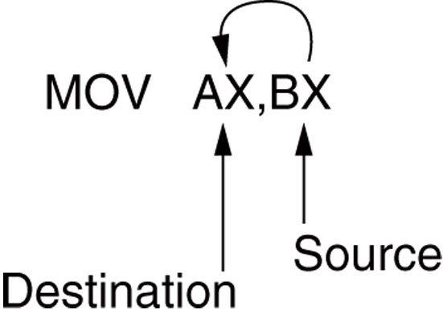
Data Addressing Modes
Figure 1 The MOV instruction showing the source, destination, and direction of data flow.

Slide 44
Data Addressing Modes
Register Addressing
The most common form of data addressing.
  once register names learned, easiest to apply.
The microprocessor contains these 8-bit register names used with register addressing: AH, AL, BH, BL, CH, CL, DH, and DL.
16-bit register names: AX, BX, CX, DX, SP, BP, SI, and DI.
In 80386 & above, extended 32-bit register names are: EAX, EBX, ECX, EDX, ESP, EBP, EDI, and ESI.
64-bit mode register names are: RAX, RBX, RCX, RDX, RSP, RBP, RDI, RSI, and R8 through R15.

Slide 45
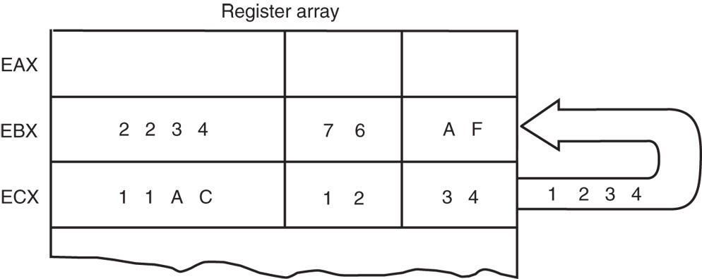
Register Addressing
Figure 2 The effect of executing the MOV BX, CX instruction at the point just before the BX register changes. Note that only the rightmost 16 bits of register EBX change.

Slide 46
Register Addressing
Figure 2 shows the operation of the MOV BX, CX instruction.
The source register’s contents do not change.
  the destination register’s contents do change
The contents of the destination register or destination memory location change for all instructions except the CMP and TEST instructions.
The MOV BX, CX instruction does not affect the leftmost 16 bits of register EBX.

Slide 47
Data Addressing Modes
Immediate Addressing
Term immediate implies that data immediately follow the hexadecimal opcode in the memory.
  immediate data are constant data
  data transferred from a register or memory location are variable data
Immediate addressing operates upon a byte or word of data.
Figure 3 shows the operation of a MOV EAX,13456H instruction.

Slide 48
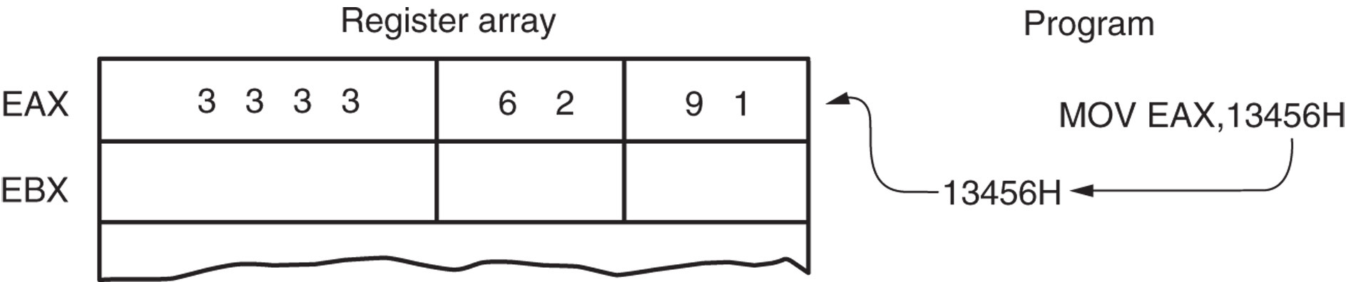
Immediate Addressing
Figure 3 The operation of the MOV EAX,3456H instruction. This instruction copies the immediate data (13456H) into EAX.

Slide 49
Immediate Addressing
In symbolic assembly language, the symbol # precedes immediate data in some assemblers.
  MOV AX,#3456H instruction is an example
Most assemblers do not use the # symbol,
but represent immediate data as in the MOV AX,3456H instruction.

Slide 50
Data Addressing Modes
Direct Data Addressing
Applied to many instructions in a typical program.
Two basic forms of direct data addressing:
  direct addressing, which applies to a MOV between a memory location and AL, AX, or EAX
  displacement addressing, which applies to almost any instruction in the instruction set
Address is formed by adding the displacement to the default data segment address or an alternate segment address.

Slide 51
Direct Data Addressing
Direct addressing with a MOV instruction transfers data between a memory location, located within the data segment, and the AL (8-bit), AX (16-bit), or EAX (32-bit) register.
  usually a 3-byte long instruction
MOV AL,DATA loads AL from the data segment memory location DATA (1234H).
  DATA is a symbolic memory location, while
  1234H is the actual hexadecimal location

Slide 52
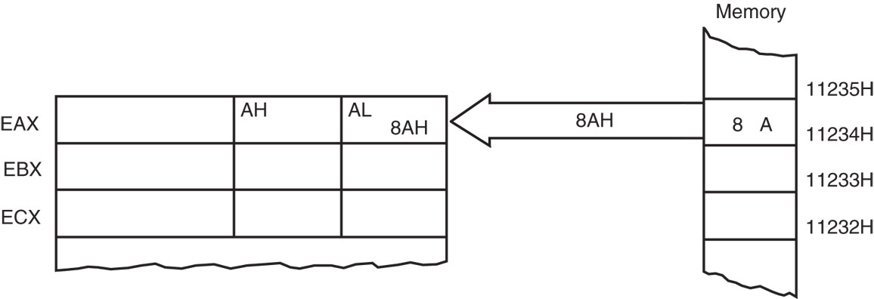
Direct Data Addressing
Figure 4 The operation of the MOV AL,[1234H] instruction when DS=1000H .
This instruction transfers a copy contents of memory location 11234H into AL.
  the effective address is formed by adding
  1234H (the offset address) and 10000H
  (the data segment address of 1000H times
  10H) in a system operating in the real mode

Slide 53
Data Addressing Modes
Register Indirect Addressing
Allows data to be addressed at any memory location through an offset address held in any of the following registers: BP, BX, DI, and SI.
In addition, 80386 and above allow register indirect addressing with any extended register except ESP.
In the 64-bit mode, the segment registers serve no purpose in addressing a location
in the flat model.

Slide 54
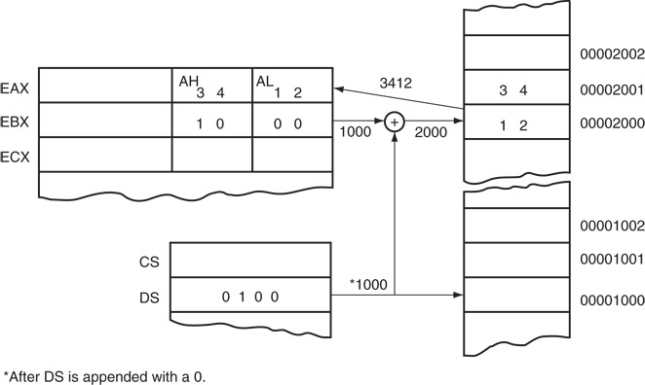
Register Indirect Addressing
Figure 5 The operation of the MOV AX,[BX] instruction when BX = 1000H and DS = 0100H. Note that this instruction is shown after the contents of memory are transferred to AX.

Slide 55
Register Indirect Addressing
The data segment is used by default with register indirect addressing or any other mode that uses BX, DI, or SI to address memory.
If the BP register addresses memory, the stack segment is used by default.
  these settings are considered the default for
  these four index and base registers
For the 80386 and above, EBP addresses memory in the stack segment by default.
EAX, EBX, ECX, EDX, EDI, and ESI address memory in the data segment by fault.

Slide 56
Data Addressing Modes
Base-Plus-Index Addressing
Similar to indirect addressing because it indirectly addresses memory data.
The base register often holds the beginning location of a memory array.
  the index register holds the relative position
  of an element in the array
  whenever BP addresses memory data, both the stack segment register and BP generate the effective address

Slide 57
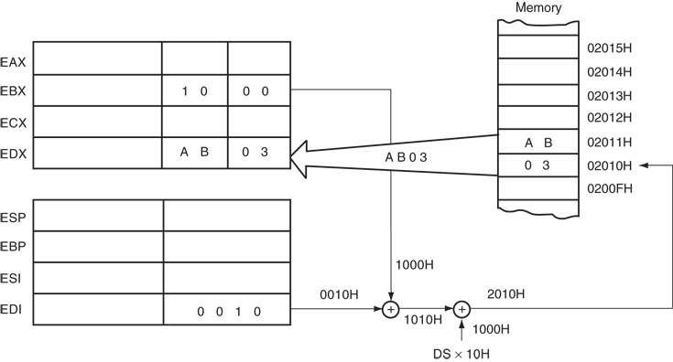
Base-Plus-Index Addressing
Figure 6 An example showing how the base-plus-index addressing mode functions for the MOV DX,[BX + DI] instruction. Notice that memory address 02010H is accessed because DS=0100H, BX=100H and DI=0010H.

Slide 58
Data Addressing Modes
Register Relative Addressing
Similar to base-plus-index addressing and displacement addressing.
  data in a segment of memory are addressed by adding the displacement to the contents of a base or an index register (BP, BX, DI, or SI)
Figure 7 shows the operation of the MOV AX,[BX+1000H] instruction.
A real mode segment is 64K bytes long.

Slide 59
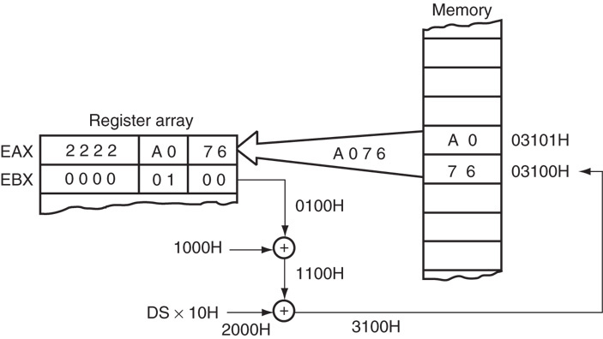
Register Relative Addressing
Figure 7 The operation of the MOV AX, [BX=1000H] instructon, when BX=1000H and DS=0200H .

Slide 60
Data Addressing Modes
Base Relative-Plus-Index Addressing
Similar to base-plus-index addressing.
  adds a displacement
  uses a base register and an index register to
  form the memory address
This type of addressing mode often addresses a two-dimensional array of memory data.

Slide 61
Base Relative-Plus-Index Addressing
Least-used addressing mode.
Figure 8 shows how data are referenced if the instruction executed by the microprocessor is MOV AX,[BX + SI + 100H].
  displacement of 100H adds to BX and SI to form the offset address within the data segment
This addressing mode is too complex for frequent use in programming.

Slide 62
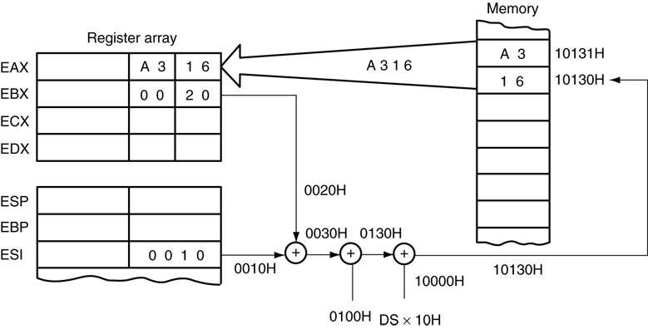
Base Relative-Plus-Index Addressing
Figure 8 An example of base relative-plus-index addressing using a MOV AX,[BX+SI=1000H] instruction. Note: DS=1000H

Slide 63
Stack memory addressing modes
The stack plays an important role in all microprocessors.
  holds data temporarily and stores return addresses used by procedures
Stack memory is LIFO (last-in, first-out) memory
  describes the way data are stored and removed from the stack

Slide 64
Stack memory addressing modes
Data are placed on the stack with a PUSH instruction; removed with a POP instruction.
Stack memory is maintained by two registers:
  the stack pointer (SP or ESP)
  the stack segment register (SS)
Whenever a word of data is pushed onto the stack, the high-order 8 bits are placed in the location addressed by SP – 1.
  low-order 8 bits are placed in the location addressed by SP – 2

Slide 65
Stack memory addressing modes
The SP is decremented by 2 so the next word is stored in the next available stack location.
  the SP/ESP register always points to an area of memory located within the stack segment.
In protected mode operation, the SS register holds a selector that accesses a descriptor for the base address of the stack segment.
When data are popped from the stack, the low-order 8 bits are removed from the location addressed by SP.
  high-order 8 bits are removed; the SP register is incremented by 2

Slide 66
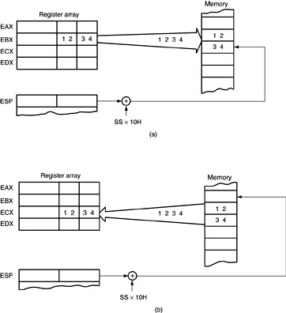
Stack memory addressing modes
Figure 9 The PUSH and POP instructions: (a) PUSH BX places the contents of BX onto the stack; (b) POP CX removes data from the stack and places them into CX. Both instructions are shown after execution.

Slide 67
Stack memory addressing modes
Note that PUSH and POP store or retrieve words of data—never bytes—in 8086 - 80286.
80386 and above allow words or doublewords to be transferred to and from the stack.
Data may be pushed onto the stack from any 16-bit register or segment register.
  in 80386 and above, from any 32-bit extended register
Data may be popped off the stack into any register or any segment register except CS.

Slide 68
Stack memory addressing modes
PUSHA and POPA instructions push or pop all except segment registers, on the stack.
Not available on early 8086/8088 processors.
80386 and above allow extended registers to be pushed or popped.
  64-bit mode for Pentium and Core2 does not contain a PUSHA or POPA instruction

Slide 69
Data Transfer Instructions

Slide 70
Data Transfer Instructions

Slide 71
Arithmetic Instructions

Slide 72
Arithmetic Instructions

Slide 73
Number Representation

Slide 74
Logical Instructions

Slide 75
String Instructions

Slide 76
Program Transfer Instructions

Slide 77
Program Transfer Instructions

Slide 78
Processor Control Instructions

Slide 79
Interrupts in 8086 microprocessor
An interrupt is a condition that halts the microprocessor temporarily to work on a different task and then return to its previous task.
Interrupt is an event or signal that request to attention of CPU.
This halt allows peripheral devices to access the microprocessor.
Whenever an interrupt occurs the processor completes the execution of the current instruction and starts the execution of an Interrupt Service Routine (ISR) or Interrupt Handler.
ISR is a program that tells the processor what to do when the interrupt occurs.
After the execution of ISR, control returns back to the main routine where it was interrupted

Slide 80
Interrupts in 8086 microprocessor
In 8086 microprocessor following tasks are performed when microprocessor encounters an interrupt:
The value of flag register is pushed into the stack. It means that first the value of SP (Stack Pointer) is decremented by 2 then the value of flag register is pushed to the memory address of stack segment.
The value of starting memory address of CS (Code Segment) is pushed into the stack.
The value of IP (Instruction Pointer) is pushed into the stack.
IP is loaded from word location (Interrupt type) * 04.
CS is loaded from the next word location.
Interrupt and Trap flag are reset to 0.

Slide 81
Interrupts in 8086 microprocessor
Types of interrupts
Hardware Interrupts
Hardware interrupts are those interrupts which are caused by any peripheral device by sending a signal through a specified pin to the microprocessor.
There are two hardware interrupts in 8086 microprocessor. They are:
(A) NMI (Non Maskable Interrupt) –
It is a single pin non maskable hardware interrupt which cannot be disabled.
It is the highest priority interrupt in 8086 microprocessor.
After its execution, this interrupt generates a TYPE 2 interrupt.
IP is loaded from word location 00008 H and CS is loaded from the word location 0000A H.

Slide 82
Interrupts in 8086 microprocessor
(B) INTR (Interrupt Request) –
It provides a single interrupt request and is activated by I/O port.
This interrupt can be masked or delayed.
It is a level triggered interrupt. It can receive any interrupt type, so the value of IP and CS will change on the interrupt type received.

Slide 83
Interrupts in 8086 microprocessor
Software Interrupts –
These are instructions that are inserted within the program to generate interrupts. There are 256 software interrupts in 8086 microprocessor. The instructions are of the format INT type where type ranges from 00 to FF. The starting address ranges from 00000 H to 003FF H. These are 2 byte instructions. IP is loaded from type * 04 H and CS is loaded from the next address give by (type * 04) + 02 H.
Some important software interrupts are:
TYPE 0 corresponds to division by zero(0).
TYPE 1 is used for single step execution for debugging of program.
TYPE 2 represents NMI and is used in power failure conditions.
TYPE 3 represents a break-point interrupt.
TYPE 4 is the overflow interrupt

