Slide 1
CSE 101:Computer Programming
Start up
User define function
Structure of a function:
Function_type Name_of_Function(list of variable with type)
{
Statement;
Statement;
---
Statement;
}
Parts:
Function_type
Name_of_Function
(list of variable with type)
{
Body of the function
}
Example:
void main()
{
printf”Body of function”);
}
We write part 1, 2 and 3 in the same line

Slide 2
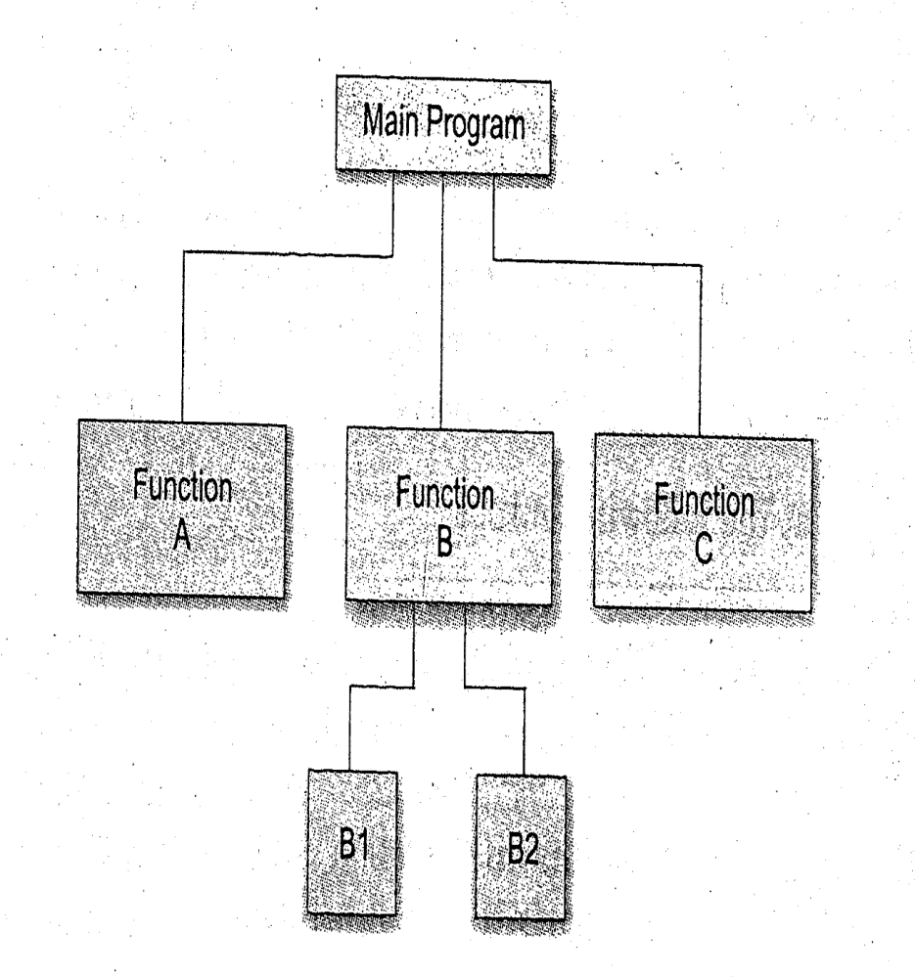
CSE 101:Computer Programming
Start up
User define function
Print Result
Main Program
Carry nothing
Return Result
Return Final
Carry MidTotal, Final
Return MidTotal
Carry nothing
Proces_MidTerm
Process_Final
Compute_ Result
Collect three mid term and add them to MidTotal
Collect two final marks and add them to Final
Add MidTotal and Final to Result
To process your results
Main
Process_MidTerm
Process_Final
Compute_Result
Function List:

Slide 3
CSE 101:Computer Programming
Start up
User define function
void main()
{
int MidTerm, Final, Result;
MidTerm=Process_MidTerm();
Final=Process_Final();
Result=Compute_Result(MidTerm,Final);
printf(“Obtained mark is %d”, Result);
}
Print Result
Main Program
Return MidTotal
Carry nothing
Return Result
Carry nothing
Return Final
Carry MidTotal, Final
Proces_MidTerm
Process_Final
Compute_ Result
int Process_MidTerm()
{
int mid1, mid2, mid3;
int MidTotal;
printf(“Enter marks of mid terms”);
scanf(“%d”, &mid1);
scanf(“%d”, &mid2);
scanf(“%d”, &mid3);
MidTotal=mid1+mid2+mid3;
return MidTotal;
}
int Process_Final()
{
int final1, final2;
int Final;
printf(“Enter marks of final”);
scanf(“%d”, &final1);
scanf(“%d”, &final2);
Final=final1+final2;
return Final;
}
int Compute_Result(int mid, int finEva)
{
int Result;
Result=mid+FinEva;
return Result;
}
To process your results

Slide 4
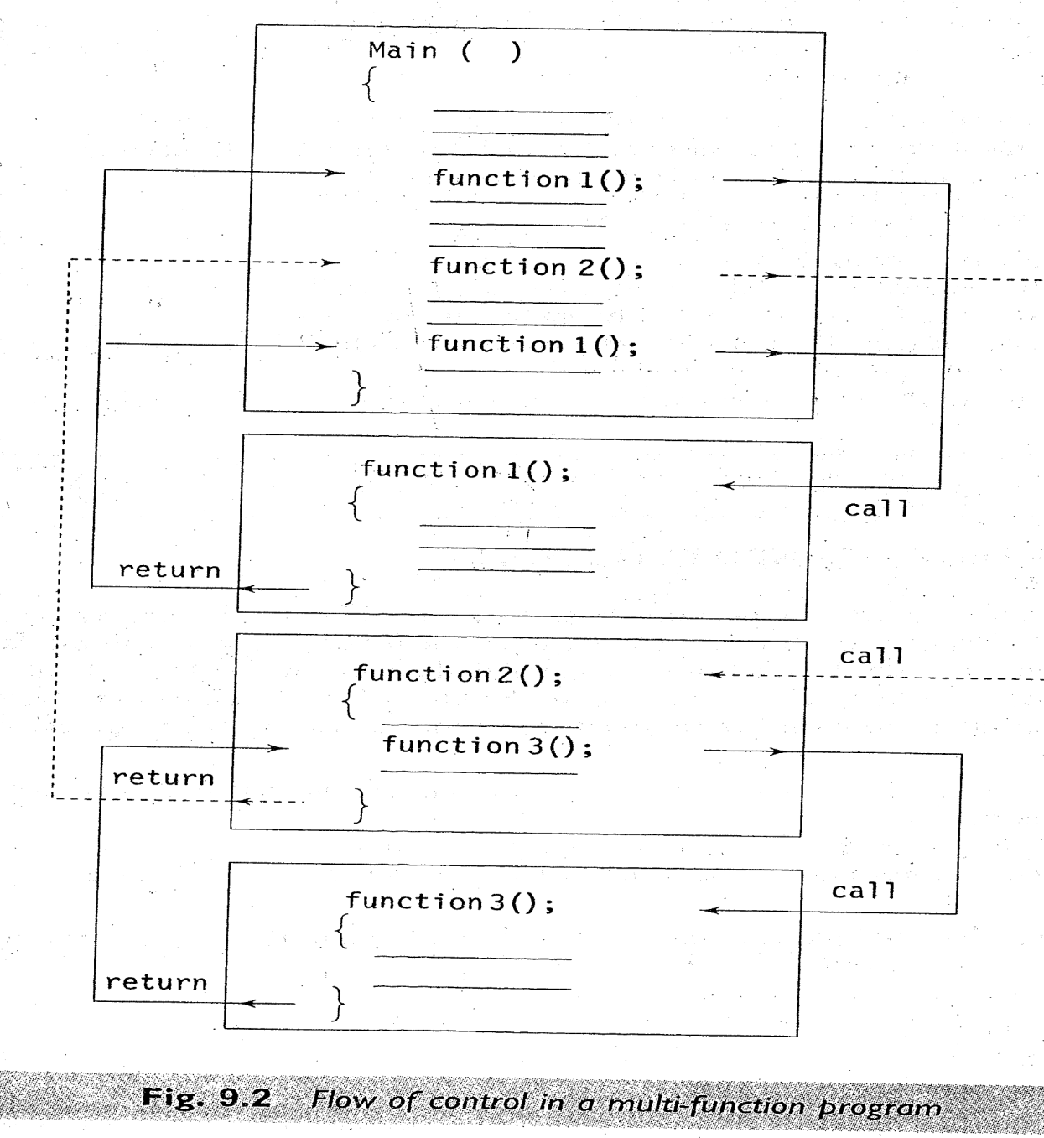
CSE 101:Computer Programming
Start up
User define function
Flow of control in a multi function program

Slide 5
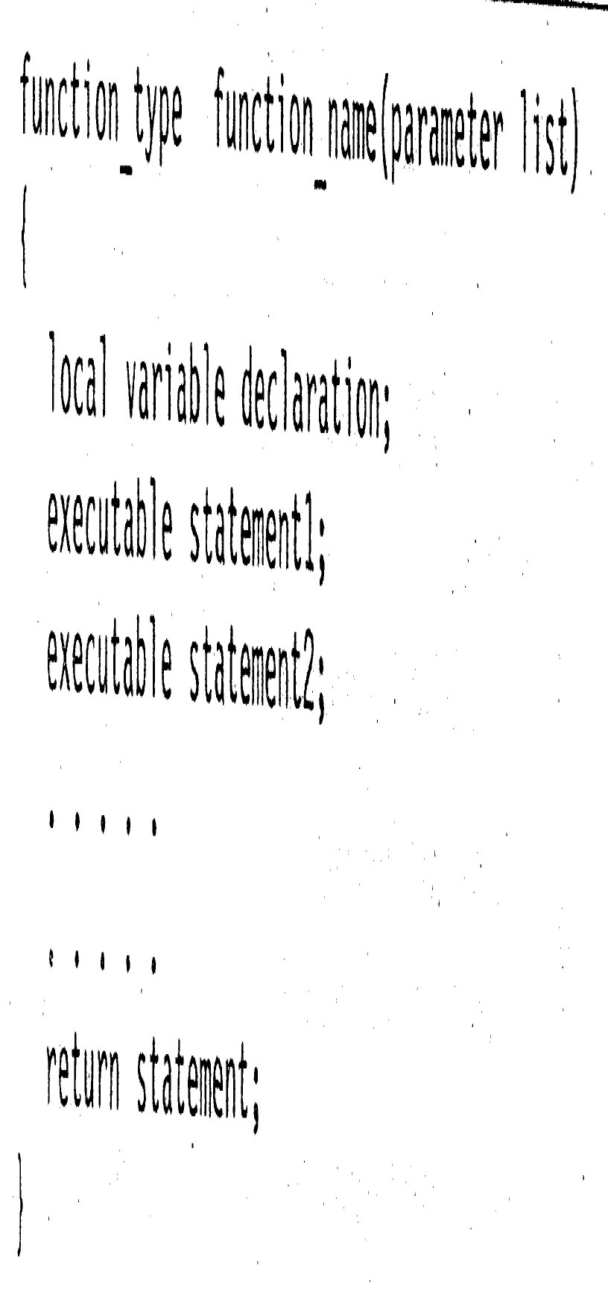
CSE 101:Computer Programming
Start up
User define function

Slide 6
CSE 101:Computer Programming
Start up
User define function

Slide 7
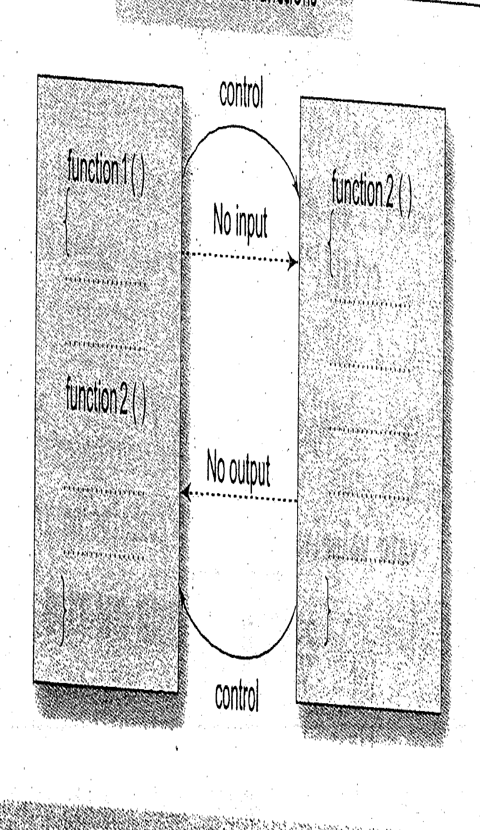
CSE 101:Computer Programming
Start up
User define function
main()
{
Result();
}
void Result()
{
int MidTotal, Final, Total;
printf(“Enter mid term total\n”);
scanf(“%d”, &MidTotal);
printf(“Enter final marks\n”);
scanf(“%d”, &Final);
Total=MidTotal+Final;
printf(“Obtain marks %d”, Total);
}

Slide 8
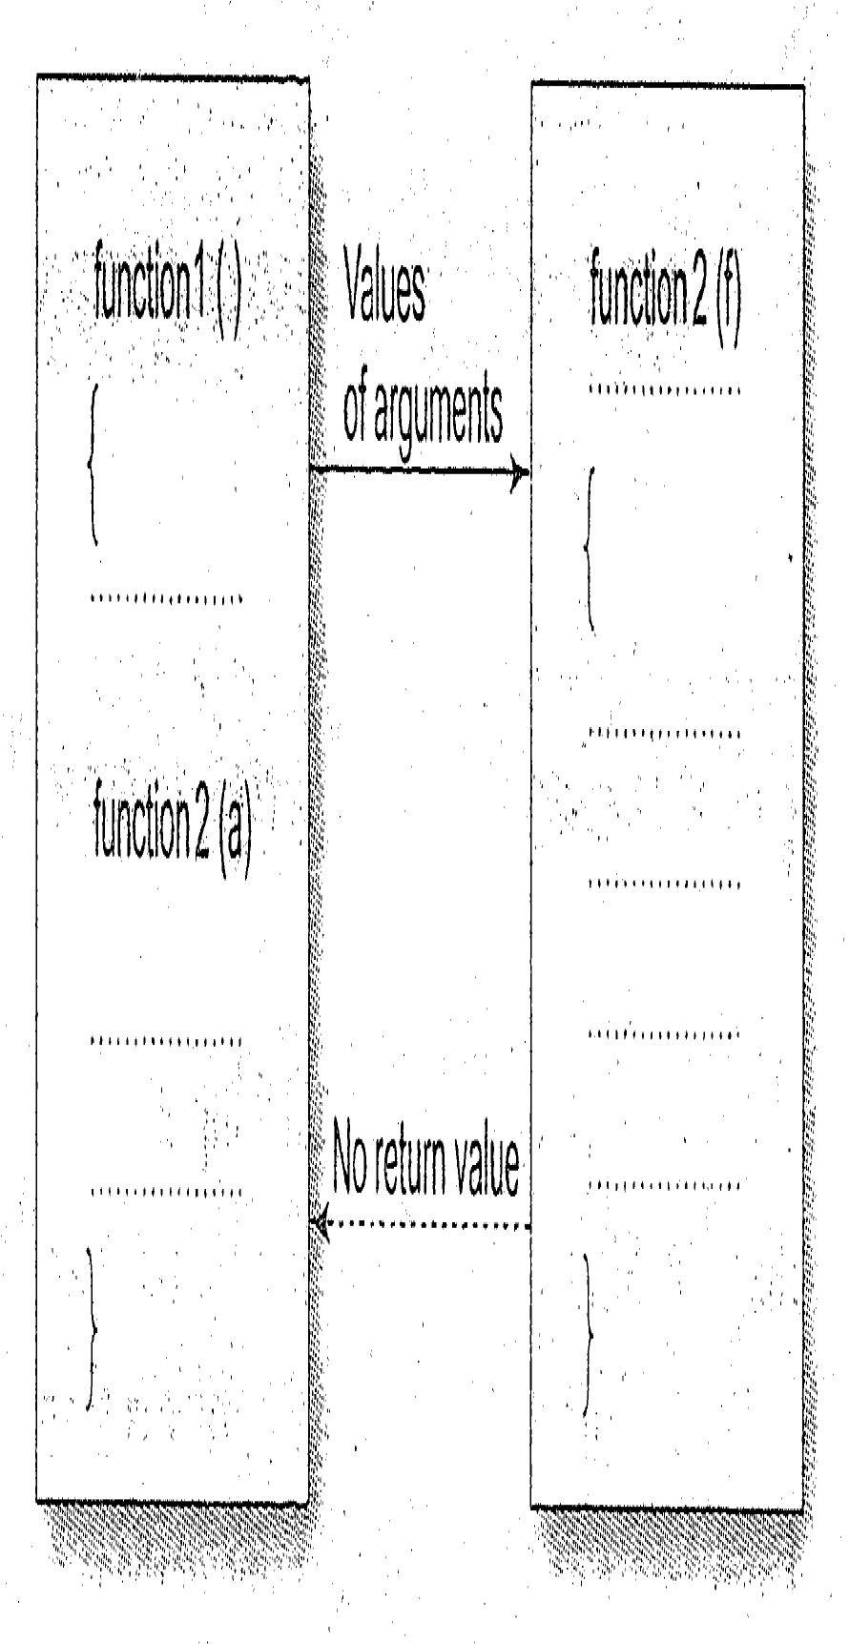
CSE 101:Computer Programming
Start up
User define function
main()
{
Int MidTotal, Final;
printf(“Enter mid term total\n”);
scanf(“%d”, &MidTotal);
printf(“Enter final marks\n”);
scanf(“%d”, &Final);
Result(MidTotal, Final);
}
void Result(int MidTotal, int Final)
{
int Total;
Total=MidTotal+Final;
printf(“Obtain marks %d”, Total);
}

Slide 9
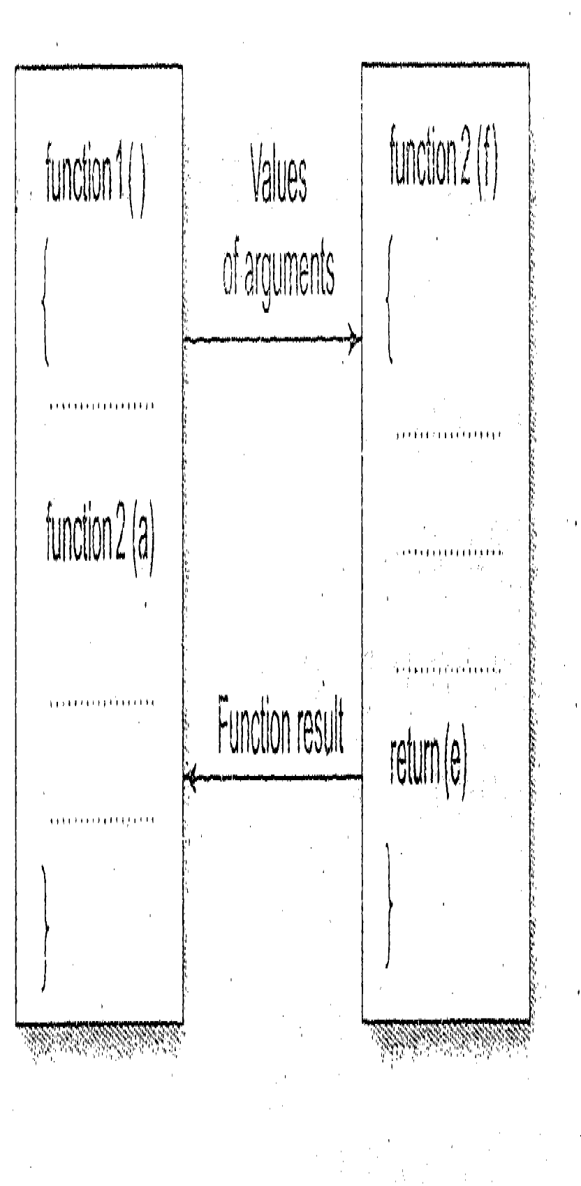
CSE 101:Computer Programming
Start up
User define function
main()
{
Int MidTotal, Final, Total;
printf(“Enter mid term total\n”);
scanf(“%d”, &MidTotal);
printf(“Enter final marks\n”);
scanf(“%d”, &Final);
Total=Result(MidTotal, Final);
printf(“Obtain marks %d”, Total);
}
int Result(int MidTotal, int Final)
{
int Total;
Total=MidTotal+Final;
return Total;
}

Slide 10
CSE 101:Computer Programming
Start up
User define function
main()
{
Int Total;
Total=Result();
printf(“Obtain marks %d”, Total);
}
int Result()
{
int MidTotal, Final, Total;
printf(“Enter mid term total\n”);
scanf(“%d”, &MidTotal);
printf(“Enter final marks\n”);
scanf(“%d”, &Final);
Total=MidTotal+Final;
return Total;
}

Slide 11
CSE 101:Computer Programming
Start up
User define function
main()
{
Int *MidTotal, *Final, Total;
Result(&MidTotal, &Final);
Total=MidTotal+Final;
printf(“Obtain marks %d”, Total);
}
C does not support to return multiple values trough return statement.
It can be achieved by passing address of an argument.
void Result(int *MidTotal, int *Final)
{
printf(“Enter mid term total\n”);
scanf(“%d”, &MidTotal);
printf(“Enter final marks\n”);
scanf(“%d”, &Final);
}

