Slide 1
CSE 5406 : Neural Signal Processing
Md. Sujan Ali
Associate Professor
Dept. of Computer Science and Engineering
Jatiya Kabi Kazi Nazrul Islam University

Slide 2
EEG Enhancement
EEG Artifacts
Although EEG is designed to record cerebral activity, it also records electrical activities arising from sites other than the brain.
The recorded activity that is not of cerebral origin is termed artifact.
Artifacts Types
Physiologic/internal and
Physiologic artifacts are arise from sources other than the brain (ie, body).
2. Extra-physiologic artifacts.
Extra-physiologic artifacts arise from outside the body (ie, equipment, environment)

Slide 3
EEG Enhancement
Different Types of Artifacts and Their Origins
Physiological/internal |  |  | Extra-physiological/external
Ocular | Cardiac | Muscle | Instrumental | Interference | Movement
Eye blink Eye movement Eye flatter REM sleep | ECG pulse | Chewing Swallowing Clenching Sniffing Talking Scalp | Electrode displacement Cable movement Poor ground | Electrical Magnetic Sound Optical EM waves | Head Body Limbs Tremor

Slide 4
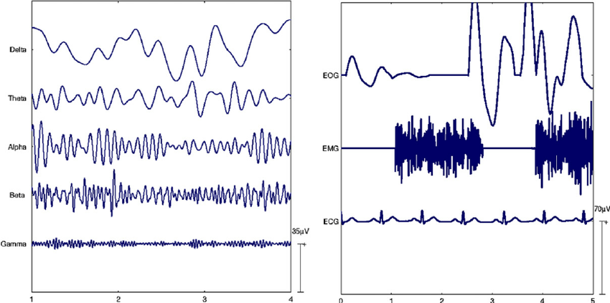
EEG Enhancement
Physiological/internal Artifacts

Slide 5
EEG Enhancement
EEG Artifacts Detection
Identifying artifacts is the first and most important step for handling artifacts.
Often the artifacts overlap with EEG signals in both spectral and temporal domains.
Such that it becomes difficult to use simple filtering or straight forward signal processing technique.
In many applications, it is required to identify or separate artifacts in real-time.
Therefore knowing both the artifact and signal characteristics is really necessary in order to detect them faster.

Slide 6
EEG Enhancement
EEG Artifacts Removal
Artifact removal involves canceling or correcting the artifacts without distorting the signal of interest.
This is done either by filtering or by separating/decomposing the EEG data into other domains.

Slide 7
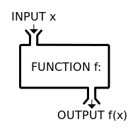
EEG Enhancement
Function
In mathematics, a function is a relation between a set of inputs and a set of outputs.
Input | Relationship | Output
0 | × 2 | 0
1 | × 2 | 2
7 | × 2 | 14
10 | × 2 | 20
... | ... | ...
The input
The relationship
The output

Slide 8
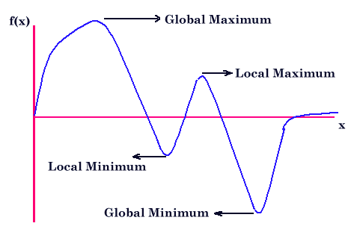
EEG Enhancement
Maxima and minima
In mathematical analysis, the maxima and minima (the respective plurals of maximum and minimum) of a function, known collectively as extrema (the plural of extremum), are the largest and smallest value of the function.

Slide 9
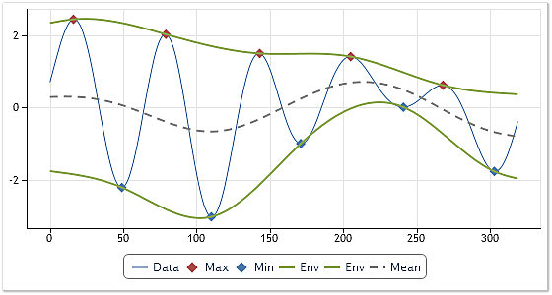
EEG Enhancement
Intrinsic Mode Function (IMF)
An IMF is defined as a function that satisfies the following requirements:
In the whole data set, the number of extrema and the number of zero-crossings must either be equal or differ at most by one.
At any point, the mean value of the envelope defined by the local maxima and the envelope defined by the local minima is zero.

Slide 10
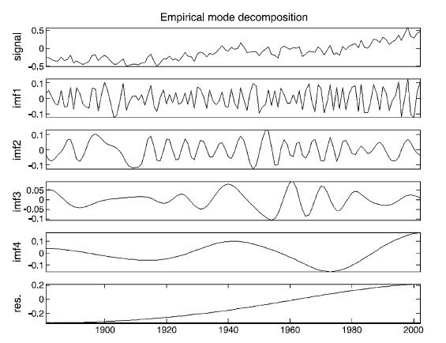
EEG Enhancement
Decomposition
The term "decomposition" formally means the breaking down of a compound signal into separate constituent components.
Empirical Mode Decomposition
The Empirical Mode Decomposition (EMD) is a signal processing decomposition technique that decomposes the signal into waveforms by extracting all of the oscillatory modes embedded in the signal.

Slide 11
EEG Enhancement
Empirical Mode Decomposition
Consider a time series data X(t) and want to extract IMFs from X(t). The procedure of extracting an IMF is called sifting. The sifting process is as follows:
IMFs extraction:
(Start Sifting Process)
1. Identify all the local extrema (both maxima and minima) in the data X(t);
2. Connect all the local maxima by a cubic spline line to produce the upper envelope h(t);
3. Similarly connect all the local minima to produce the lower envelope l(t);
4. Determine the local mean m1(t) = (h(t)+l(t))/2;
5. IMF testing:
the difference between the X(t) and m1(t) is the first component g1(t):
g1(t) = X(t)−m1(t);
Ideally, g1(t) should satisfy the definition of an IMF. If it is so, skip step 6.

Slide 12
EEG Enhancement
Empirical Mode Decomposition
6. If g1(t) is not an IMF then the process is shifted and in the next step, g1(t) is treated as data. The above process (1 to 5) is repeated and gets the next possible IMF as
g2(t)= g1(t)-m2(t)
After repeated sifting up to necessary k times, gk(t) becomes an IMF, that is
gk(t)= g(k-1)(t)- mk(t)
Then, gk(t) is designated as the first IMF component of the data X(t):
C1(t)= gk(t)
(End of Sifting Process)

Slide 13
EEG Enhancement
Empirical Mode Decomposition
7. Once the first IMF is derived, define C1(t) = g1(t) or gk(t) (if step 6 is executed) is the shortest period component of the data X(t). To find all the IMFs, generate the residue r1(t) of the data by subtracting out C1(t) from the data as
r1(t) = X(t)−C1(t)
The residue now contains information about the components for longer period; it is treated as the new data. This procedure can be repeated (step 1 to step 7) for all the subsequent residue and the result is
r_{n}(t)= r_{n-1}(t) – C_{n}(t)
The sifting process finally stops when the residue, r_{n}(t), becomes a monotonic function from which no more IMF can be extracted. From the above equations, we can induce that
where n is the number of IMFs and r_{n} (t) is the final residue.

Slide 14
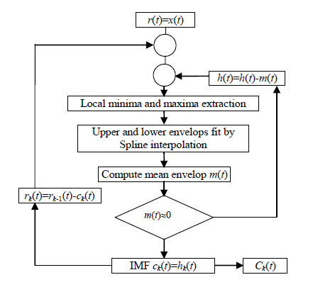
EEG Enhancement
Empirical Mode Decomposition
Sifting Process:

Slide 15
EEG Enhancement
Empirical Mode Decomposition
The stoppage criterion determines the number of sifting steps to produce an IMF. Following is the one of the existing stoppage criterion:
Standard Deviation
This criterion is proposed by Huang et al. (1998). It is similar to the Cauchy convergence test, and we define a sum of the difference, SD, as
Then the sifting process stops when SD is smaller than a pre-given value.

Slide 16
EEG Enhancement
Limitations of EMD
The EMD is limited in distinguishing different components in narrow-band signals.
End effect occurs at the beginning and end of the signal because there is no point before the first data point and after the last data point to be considered together. In most cases, these end points are not the extreme value of the signal. While doing the EMD process of the HHT, the extreme envelope will diverge at the end points and cause significant error. This error distorts the IMF waveform at its endpoints.
Mode mixing problem happens during the EMD process. This problem makes it hard to implement feature extraction.

Slide 17
Assignment 2
Date 05.10.2017 at 10.00 am
Take EEG containing EOG.
Apply EMD on it and plot.
Compute log₂ energies of its IMFs and plot.
Sum the 3-4 IMFs contains highest energies and consider it as EOG.
Sum rest of the IMFs including residue and consider it as EEG.

Slide 18
Midterm
Date 03.10.2017 at 10.30 am
Time-Frequency representation: Review of Fourier analysis, windowing, uncertainty principle, Discrete Fourier Transforms (DFT), limitation of DFT, Short Time Fourier Transform (STFT), wavelet basics and wavelet transforms.

