Slide 1

Chapter 1
Fundamentals of Computer Design

Slide 2
Introduction
Computer Design
Computer design is the process of creating computer systems that efficiently execute programs while balancing performance, cost, power consumption, and reliability.
It involves both:
Hardware design (CPU, memory, I/O systems)
Software-hardware interaction (compilers, operating systems)

Slide 3
Introduction
Computer Design
A well-designed computer system ensures:
Fast execution
Efficient resource usage
Scalability for future needs
At its core, computer design bridges the gap between theoretical computation and practical implementation.

Slide 4
Definition of Performance
Performance
Performance is a measure of how efficiently a computer system executes a task.
Key Metrics of Performance
Execution Time (Latency)
  Time taken to complete a task
  Lower is better
Throughput
  Number of tasks completed per unit time
  Higher is better

Slide 5
Definition of Performance
CPU Performance Formula
Where:
Instruction Count (IC) = Number of instructions in a program
CPI (Cycles Per Instruction) = Average cycles per instruction
Clock Cycle Time = Duration of one clock cycle

Slide 6
Problem 1
A program executes 5 × 10⁶ instructions on a processor. The average CPI = 2.5, and the clock cycle time = 4 ns.
Tasks:
Calculate the total CPU execution time.
If the clock cycle time is reduced to 2 ns, what will be the new CPU time?
Comment on how clock speed affects performance.

Slide 7
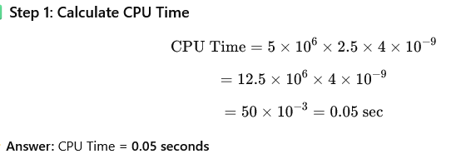
Problem 1 Solution
Given:
Instruction Count (IC) = 5×10⁶
CPI = 2.5
Clock Cycle Time = 4 ns=4×10⁻⁹ sec

Slide 8
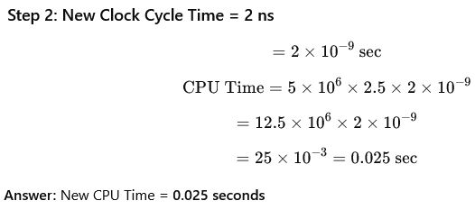
Problem 1 Solution
Step 3:
Reducing clock cycle time increases clock speed, which reduces CPU time proportionally.
Performance improves directly when clock cycle time decreases.

Slide 9
Problem 2
A processor runs a program in 0.08 seconds. The program consists of 2 × 10⁶ instructions, and the clock cycle time is 5 ns.
Tasks:
Determine the average CPI of the processor.
If an optimization reduces the CPI by 20%, calculate the new CPU time.
Which factor (CPI or clock cycle time) would be more effective to improve performance in this case? Justify.

Slide 10
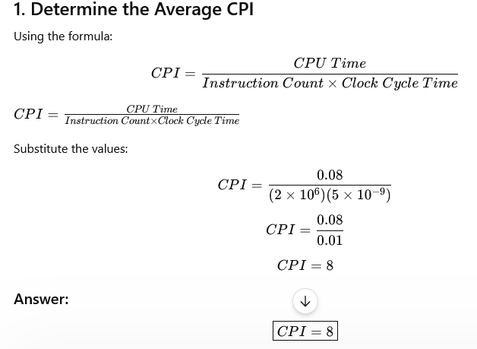
Problem 2 Solution

Slide 11
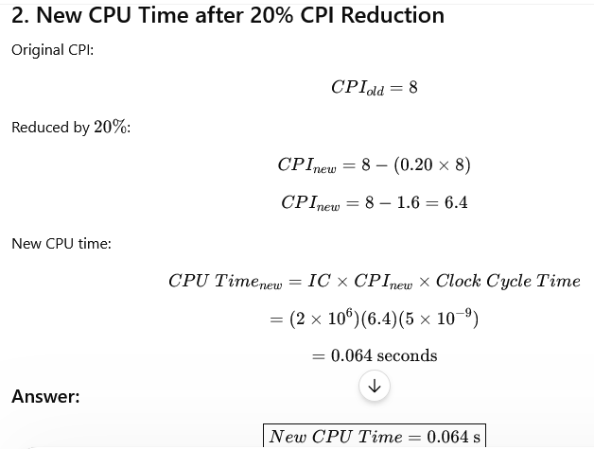

Problem 2 Solution

Slide 12
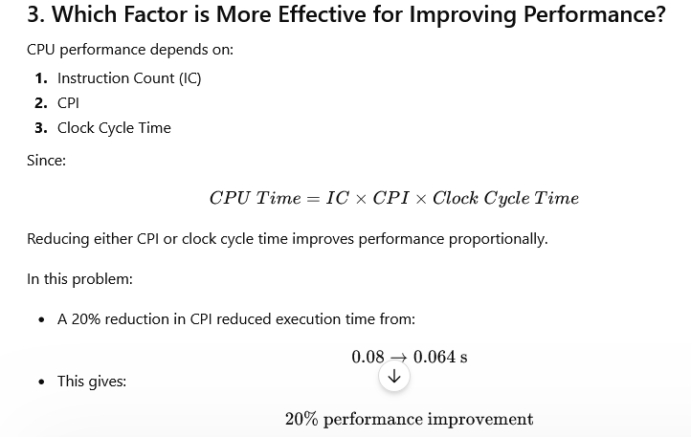
Problem 2 Solution

Slide 13
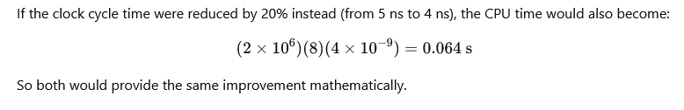
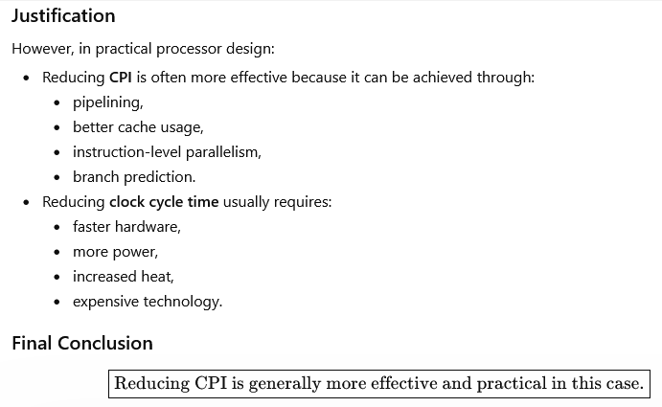
Problem 2 Solution

Slide 14
Job of Computer Designer
A computer designer’s role is to make decisions that optimize system performance under constraints.

Slide 15
Job of Computer Designer
Key Responsibilities
a) Instruction Set Design
Define operations a computer can perform
Balance simplicity vs capability
b) Hardware Organization
Design CPU, ALU, registers, cache, memory hierarchy
Ensure efficient data flow

Slide 16
Job of Computer Designer
c) Performance Optimization
Use pipelining*, parallelism*, caching*
Reduce bottlenecks*
d) Cost and Power Management
Minimize manufacturing cost
Ensure energy efficiency (important for mobile/embedded systems)
e) Reliability and Scalability
Ensure system stability
Allow future upgrades

Slide 17
Pipelining
Pipelining is a technique where multiple instruction stages are processed simultaneously, similar to an assembly line in a factory.
Instead of waiting for one instruction to complete entirely, the processor starts executing the next instruction while the previous one is still being processed.

Slide 18
Pipelining Example
Without pipelining:
Only one instruction works at a time.
Suppose there are 3 instructions:
I1 = ADD
I2 = SUB
I3 = MUL
Clock Cycle | Operation
1 | Fetch I1
2 | Decode I1
3 | Execute I1
4 | Fetch I2
5 | Decode I2
With pipelining:
Many instructions progress together.
Cycle | Stage 1 | Stage 2 | Stage 3
1 | Fetch I1
2 | Fetch I2 | Decode I1
3 | Fetch I3 | Decode I2 | Execute I1

Slide 19
Parallelism
Parallelism means executing multiple tasks or computations at the same time using multiple processors, cores, or machines.

Slide 20
Types of Parallelism
A. Data Parallelism
Same operation on different data.
Example
Adding 1000 numbers using multiple cores.
Core 1 → Sum first 250 numbers
Core 2 → Sum next 250 numbers

Slide 21
Types of Parallelism
B. Task Parallelism
Different tasks run simultaneously.
Example
While:
One thread downloads a file
Another thread plays music
Another thread updates UI

Slide 22
Example in Daily Life of Parallelism
Cooking:
One person cuts vegetables
Another cooks rice
Another prepares salad
Tasks happen simultaneously.

Slide 23
Caching
Caching stores frequently used data in a small, high-speed memory so the processor can access it quickly.
Why Cache is Needed
CPU is much faster than RAM.
Without cache:
CPU waits for data from slow memory.
Cache reduces waiting time

Slide 24
Cache Hierarchy
Cache Type | Speed | Size
L1 Cache | Fastest | Smallest
L2 Cache | Faster | Medium
L3 Cache | Slower | Larger
Example
Suppose you repeatedly open the same application.
First time:
Data loaded from hard disk → slow
Next time:
Data comes from cache → fast

Slide 25
Real-Life Analogy of
Cache Hierarchy
A student keeps important books on the study table instead of going to the library repeatedly.
Study table = Cache
Library = Main memory

Slide 26
Bottlenecks
A bottleneck is a component that limits overall system performance.
Even if other parts are fast, one slow component can reduce the total speed.

Slide 27
Common Bottlenecks
Component | Problem
CPU | Slow processing
RAM | Insufficient memory
Disk | Slow storage
Network | Low bandwidth

Slide 28
Example of bottleneck
A fast CPU with very slow hard disk:
CPU waits for data
Overall system becomes slow
The hard disk becomes the bottleneck.

Slide 29
Methods to Reduce Bottlenecks
A. Upgrade Hardware
SSD instead of HDD
More RAM
Faster CPU
B. Load Balancing
Distribute tasks evenly.
Example:
Web requests handled by multiple servers.
C. Efficient Algorithms
Use optimized algorithms requiring less time.
Example:
Binary search instead of linear search.
D. Parallel Processing
Split workload among multiple processors.

Slide 30
Historical Perspectives
Understanding history helps explain why modern systems are designed the way they are.
a) Early Mechanical Computers (Pre-1940s)
Example: Charles Babbage’s Analytical Engine
Mechanical and limited
b) First Generation (1940s–1950s)
Vacuum tubes
Example: ENIAC
Large, slow, high power consumption

Slide 31
Historical Perspectives
c) Second Generation (1950s–1960s)
Transistors replaced vacuum tubes
Smaller, faster, more reliable
d) Third Generation (1960s–1970s)
Integrated Circuits (ICs)
Reduced size and cost

Slide 32
Historical Perspectives
e) Fourth Generation (1970s–Present)
Microprocessors
Personal computers emerge
f) Modern Era
Multi-core processors
GPUs, AI accelerators
Cloud computing and distributed systems

Slide 33
Combinational Circuits
Definition
A combinational circuit is a type of digital circuit in which the output depends only on the present inputs, not on past inputs or memory.
It does not use memory elements (like flip-flops).
It is made up of logic gates (AND, OR, NOT, NAND, NOR, XOR, XNOR).
The relation between input and output can be expressed by Boolean functions.

Slide 34
Combinational Circuits
Characteristics
Memoryless: No storage capability; output changes immediately when input changes.
Deterministic: For a given set of inputs, the output is always the same.
Time-independent: Output depends only on the present input, not on time sequence.
Implementable using gates: Realized using ICs like 7400 (NAND), 7408 (AND), etc.

Slide 35
Combinational Circuits
Basic Building Blocks
Combinational circuits are built using the following basic gates:
NOT gate (Inverter) → Output is the complement of input.
AND gate → Output is 1 only if all inputs are 1.
OR gate → Output is 1 if any input is 1.
NAND gate → Complement of AND output.
NOR gate → Complement of OR output.
XOR gate → Output is 1 if odd number of inputs are 1.
XNOR gate → Complement of XOR.

Slide 36
Combinational Circuits
Design Procedure for Combinational Circuits
When designing a combinational circuit, follow these steps:
Problem Definition → Understand the functionality (e.g., design a circuit that adds two bits).
Determine Inputs and Outputs → Define input variables and desired outputs.
Construct Truth Table → Show all possible input combinations and their corresponding outputs.
Derive Boolean Expressions → Using truth table, express outputs in terms of inputs.
Simplify Boolean Functions → Use Boolean algebra or Karnaugh maps (K-map) to minimize logic.
Implement the Circuit → Draw the logic gate diagram using available gates.
Verify and Test → Ensure correctness using simulation or breadboard/FPGA.

Slide 37
Combinational Circuits
Types of Standard Combinational Circuits
Adders
  Half Adder → Adds two bits, produces Sum & Carry.
  Full Adder → Adds three bits (A, B, Cin), produces Sum & Carry.
Subtractors
  Half Subtractor → Subtracts two bits, gives Difference & Borrow.
  Full Subtractor → Subtracts three bits (A, B, Bin), gives Difference & Borrow.
Multiplexers (MUX)
  Selects one input out of many inputs using select lines.
  Example: 4-to-1 MUX selects one input based on 2 control signals.
Demultiplexers (DEMUX)
  Takes one input and routes it to one of many outputs, based on select lines.

Slide 38
Combinational Circuits
Types of Standard Combinational Circuits
Encoders
  Converts 2^n inputs into n outputs (binary form).
  Example: Decimal-to-binary encoder.
Decoders
  Converts n inputs into 2^n outputs.
  Example: Binary-to-7-segment decoder.
Comparators
  Compares two binary numbers (A and B) and outputs whether A = B, A > B, A < B.
Code Converters
  Convert from one code to another (e.g., BCD to Excess-3, Binary to Gray code).

Slide 39
Combinational Circuits
Applications of Combinational Circuits
Arithmetic operations (ALU in microprocessors).
Data selection and routing (MUX/DEMUX in memory and communication systems).
Code conversion (digital displays, communication encoding).
Comparison (digital control and processors).
Logic implementation (control units in microprocessors).

Slide 40
Sequential Circuits
Definition
A sequential circuit is a type of digital circuit in which the output depends on both present inputs and past history (previous outputs).
Unlike combinational circuits, sequential circuits contain memory elements (flip-flops, latches).
These memory elements store the previous states.
Thus, the behavior of sequential circuits is described by state tables, and timing diagrams.

Slide 41
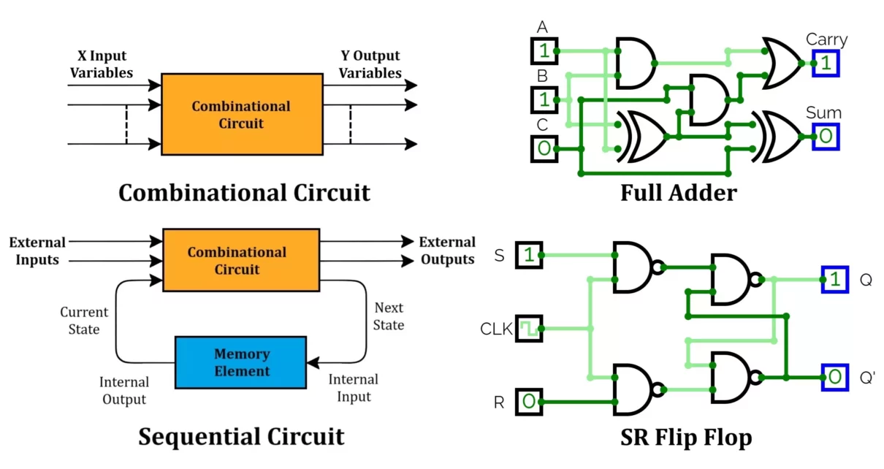
Combinational Vs Sequential Circuits

Slide 42
Sequential Circuits
Characteristics
Dependence on past input: The present output depends not only on inputs but also on the stored state.
Contain memory: Flip-flops (basic storage elements) are used.
Time-dependent behavior: Sequential circuits change their states with time.

Slide 43
Sequential Circuits
Basic Building Blocks
Flip-Flops (fundamental memory element)
  SR Flip-Flop → Set/Reset
  JK Flip-Flop → Universal flip-flop (solves SR invalid state)
  D Flip-Flop → Data/Delay flip-flop (most used in registers)
  T Flip-Flop → Toggle flip-flop (used in counters)
Latches
  Level-sensitive storage devices.
Registers
  Group of flip-flops to store multi-bit data.
Counters
  Sequential circuits that go through a predetermined sequence of states (binary, decade, up/down).

Slide 44
Sequential Circuits
Applications of Sequential Circuits
Microprocessors and controllers: Instruction execution, control unit design.
Memory devices: Registers, RAM, ROM.
Counters and timers: Digital clocks, frequency dividers.
Communication: Serial data transmission, error detection.
Control systems: Traffic light controllers, elevators, vending machines.
Digital signal processing: Shift registers for filtering and storage.

Slide 45
Register-Level Components
Definition of a Register
A register is a collection of flip-flops (usually D flip-flops) used to store multi-bit binary information.
Example: A 4-bit register can store 1010 (binary data).
Registers are used extensively inside microprocessors,
memory units, and control units.

Slide 46
Register-Level Components
Types of Registers
(a) General Purpose Registers (GPRs)
Store data temporarily during program execution.
Used by the Arithmetic Logic Unit (ALU) for operations.
Example (Intel 8086): AX, BX, CX, DX.

Slide 47
Register-Level Components
Types of Registers
(b) Special Purpose Registers
Accumulator (ACC) → Holds intermediate results of ALU operations.
Program Counter (PC) → Holds the address of the next instruction.
Instruction Register (IR) → Holds the current instruction being executed.
Memory Address Register (MAR) → Holds the memory location to be accessed.
Memory Data Register (MDR) → Holds data read from or written to memory.
Stack Pointer (SP) → Points to the top of the stack in memory.
Status Register / Flag Register → Holds condition flags (Zero, Carry, Sign, Overflow).

Slide 48
Design Methodology of Register-Level Components
1. Specification
Define the function of the component:
  Is it a data storage register (hold a value)?
  A counter (sequence of values)?
  A shift register (move data left/right)?
  A special-purpose register (PC, IR, MAR, SP, etc.)?
Example: “Design a 4-bit register to store intermediate ALU results.”

Slide 49
Design Methodology of Register-Level Components
2. Determine Inputs and Outputs
Inputs:
  Data input (D) lines (parallel or serial).
  Control signals:
    Clock (for synchronization).
    Load/Enable (to allow data writing).
    Clear/Reset (to initialize to 0).
    Shift control (for shift registers).
Outputs:
  Stored data (Q).
  Status flags (e.g., zero, carry, overflow for flag registers).

Slide 50
Design Methodology of Register-Level Components
3. Select Storage Elements
Use Flip-Flops (basic storage units).
  D Flip-Flop → widely used in registers (simple data storage).
  JK/T Flip-Flops → useful for counters.
Number of Flip-Flops = Number of Bits in the Register.
  Example: 8-bit register → 8 D Flip-Flops in parallel.

Slide 51
Design Methodology of Register-Level Components
4. Derive Functional Requirements
Use truth tables, state diagrams, or Boolean equations depending on the type of component:
Simple Register:
Counter:
Shift Register:
Special Registers:

Slide 52
Design Methodology of Register-Level Components
5. Logic Circuit Design
Implement the next-state equations using logic gates + flip-flops.
Add multiplexers if multiple operations are needed (e.g., load vs shift vs clear).
Example:
A 4-bit register with load and clear:
  Each flip-flop input comes from a MUX that selects between D-input (for load), 0 (for clear), or Q (hold).

Slide 53
Design Methodology of Register-Level Components
6. Control Signal Integration
Provide control lines that dictate when and how the register changes:
  Load (LD): When active, data is loaded from input lines.
  Shift (SH): When active, data shifts left/right.
  Clear (CLR): Resets register to zero.
  Enable (EN): Allows data output or tri-state operation (for bus interfacing).

Slide 54
Design Methodology of Register-Level Components
7. Verification
Prepare a truth table or timing diagram to verify operation.
Timing Diagram
A timing diagram is a graphical representation that shows how digital signals (inputs, outputs, and clocks) change with time.
The horizontal axis → represents time.
The vertical axis → represents logic levels (0 = LOW, 1 = HIGH).
Timing diagrams illustrate the relationship between multiple signals in a digital circuit.
What is the Purpose of Timing Diagrams?

Slide 55
Design Methodology of Register-Level Components
8. Implementation
Small designs → logic gates + flip-flops.
Large designs → HDL (Verilog/VHDL) or register files in processor datapath.
A Hardware Description Language (HDL) is a specialized computer language used to describe, model, and simulate digital circuits and systems (like registers, ALUs, processors, and entire microchips).
Popular HDLs
Verilog HDL → widely used in industry.
VHDL (VHSIC Hardware Description Language) → used in defense and aerospace systems.
SystemVerilog → advanced version of Verilog with verification features.
Why HDL is Important in Microprocessor & Interfacing?

Slide 56
Design Methodology of Register-Level Components
Summary of Design Steps
Define function (storage, count, shift, control).
Identify inputs/outputs (data, control, status).
Choose flip-flop type.
Write next-state equations or state diagram.
Implement logic with gates + multiplexers.
Add control signals (Load, Clear, Shift, Enable).
Verify with truth table & timing diagram.
Implement in hardware/HDL.

Slide 57
Processor-Level Components
Definition
Processor-level components are the major building blocks inside a microprocessor (CPU) that work together to fetch, decode, and execute instructions.
Processor-level components include the ALU, Control Unit, Register File, Instruction Register, Program Counter, Flags Register, Instruction Decoder, System Bus, and Clock Unit.
They form the core functional units of the CPU that coordinate to execute instructions.

Slide 58
Design Techniques of Processor-Level Components
Specification → What should the component do?
RTL Design → Express in register-transfer operations.
Functional Decomposition → Break into datapath + control unit.
Logic Design → Derive logic circuits for ALU, PC, CU, etc.
Control Strategy → Choose hardwired or microprogrammed.
Bus and Interface → Design data paths and control signals.
Verification → Truth tables, timing diagrams, simulation.
Implementation → Gates, HDL, FPGA, or VLSI.

Slide 59


