Slide 1

07142105; Digital Logic Design
Presented by
Professor Mst. Jannatul Ferdous, PhD
Dept. of Computer Science & Engineering
Jatiya Kabi Kazi Nazrul Islam University, Trishal, Mymensingh-2224, Bangladesh.
30th July, 2025

Slide 2
Course Contents
Boolean algebra, De Morgan’s Theorems, logic gates and their truth tables, canonical forms, combination logic circuits, minimization techniques; Arithmetic and data handling logic circuits, decoders and encoders, multiplexers and de-multiplexers; Combinational circuit design; Flip-flops, race around problems; Counters: asynchronous counters, synchronous counters and their applications; Reliable Design and Fault Detection; PLA design; Synchronous and asynchronous logic design; State diagram, Mealy and Moore machines; State minimizations and assignments; State Recognizer and Transition Graphs; Pulse mode logic; Fundamental mode design.

Slide 3
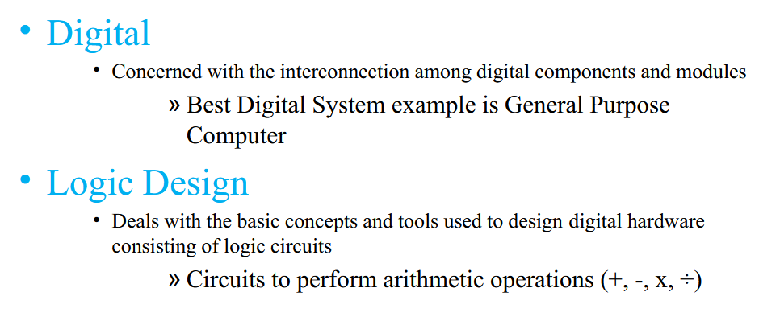

Slide 4
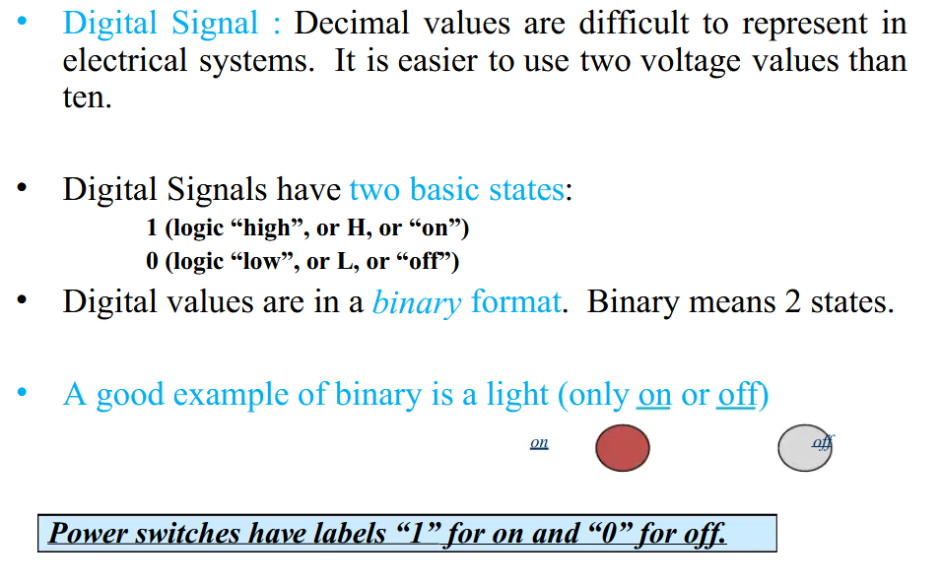

Slide 5
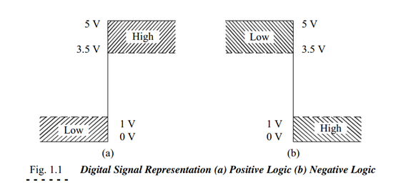

Slide 6
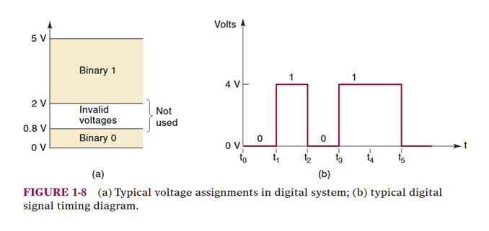
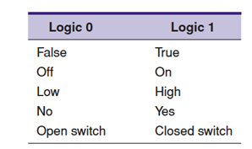
Boolean algebra
Boolean algebra differs in a major way from ordinary algebra because Boolean constants and variables are allowed to have only two possible values,0 or 1.
Boolean 0 and 1 do not represent actual numbers but instead represent the state of a voltage variable, or what is called its logic level. (R.P.Jain-37)

Slide 7
Boolean algebra was developed by English mathematician George Bole in 1854. Boolean algebra is a mathematical formulation that deals logical operations, where there are only two states 0 (OFF) and 1 (ON). In normal mathematical algebra, a
variable can have different range of values 0, 1, 2,3 … and so on, but in Boolean algebra there are only two values 1 (True/On) and 0 (False/Off).

Slide 8

De Morgan’s Theorems
DeMorgan’s theorems are extremely useful in simplifying expressions in which a product or sum of variables is inverted. The two theorems are:
First theorem says that when the OR sum of two variables is inverted, this is the same as inverting each variable individually and then ANDing these inverted variables.
Second theorem says that when the AND product of two variables is inverted; this is the same as inverting each variable individually and then ORing them.

Slide 9
Number System and Codes
The digital signals are discrete in nature and can only assume one of the two values 0 or 1.
A number system based on these two digits is known as binary number system.
Binary codes represent data, such as alphabets, number (0-9) and other symbol in a standard code called binary code.

Slide 10
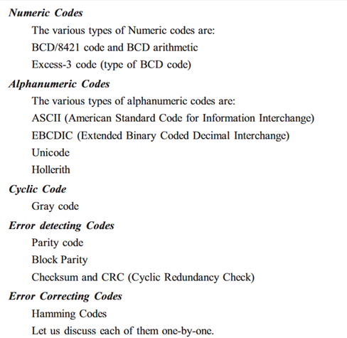

Slide 11
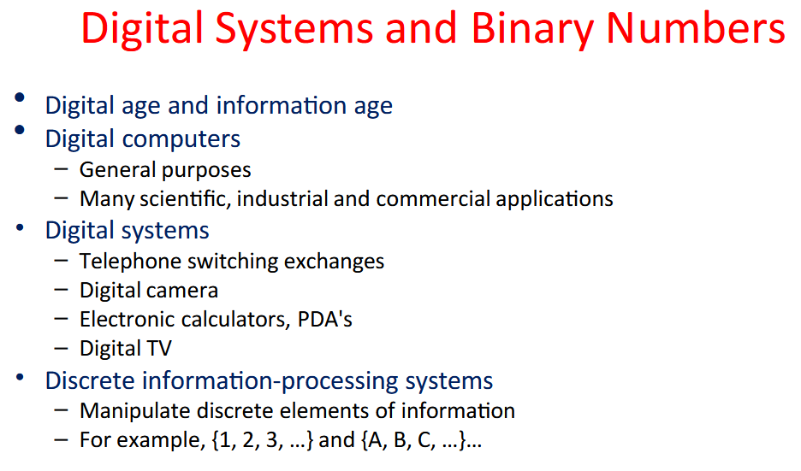

Slide 12
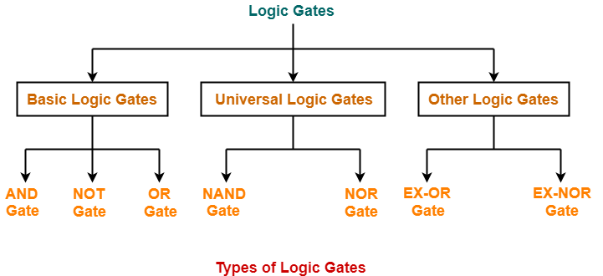
Logic Gates
Logic gates are the digital circuits capable of performing a particular logic function by operating on a number of binary inputs.
OR
Logic gates are the basic building blocks of any digital circuit.

Slide 13
Applications of OR Gate
Automatic Watering System: OR gate can be used to create a simple watering system. If any of the sensors demand water (high) then the output will become high means the watering system will turn on.
Home Automation: OR gates can be part of home automation systems. They can be used to combine signals from various sensors and switches to trigger specific actions, such as turning on the heating or cooling system when any room temperature exceeds or declines a specific number.
Emergency Lighting: In the event of a power outage, OR gates can be used to combine signals from multiple emergency switches if any of the switches is high means turned on then emergency lighting will turn on.

Slide 14
Advantages of OR Gate
Simplicity: OR gates are simple and easy-to-use logic gates. Their design is also simple and understandable.
Flexibility: OR gate works with also works with multiple inputs which increases their applications and digital use so it's very flexible to use.
High Importance: OR gates are said to be fundamental building blocks in digital electronics. They act as a base for complex IC(integrated circuits). Without OR Gate making circuits is not possible.
Implementation of Logical Functions: Creating Functionality of other logic gates such as NAND, NOR, and XOR gates, is possible using OR gate.
Disadvantages of OR Gate
Loss of Information: By OR Gate functionality we can only understand that one of the provided many inputs is high but we cannot know which of the input is high so it doesn't provide complete information.
Lack of Precision: In certain applications that require precise decision-making based on individual input values, the OR gate might not be suitable as it only produces a binary output (1 or 0).
Non-Invertible: The OR gate is not invertible; its output is always high (1) when at least one input is high (1). It cannot produce a low output (0) for any specific input combination.
Increased Power Consumption: Since the OR gate requires more transistors compared to other basic gates like NOT and AND gates, it can consume more power in complex circuits.

Slide 15
Truth Table
A truth table provides a method for mapping out the possible truth values in an expression and to determine their outcomes. The table includes a column for each variable in the expression and a row for each possible combination of truth values. It also includes a column that shows the outcome of each set of values.
The table used to represent the Boolean expression of a logic gate function is commonly called a Truth Table. A logic gate truth table shows each possible input combination to the gate or circuit with the resultant output depending upon the combination of these input(s).

Slide 16
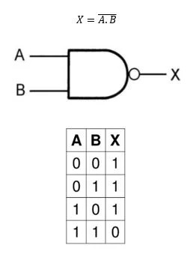
The truth table is a systematic representation of all truth values of a logical expression. It consists of all the inputs and gives the required output. It takes a combination of inputs to get the desired output. Truth tables are mainly used in Boolean algebra so, a variable can take two values 0 or 1.
The truth table is primarily used in digital circuits where it is used to validate the output generated from the various input combinations of the logical expressions. It is also used in mathematics and other fields which use Boolean logic and digital logic.
Truth Table for Binary Operations

Slide 17
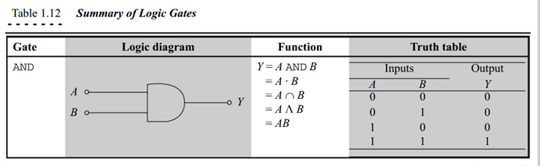

Slide 18
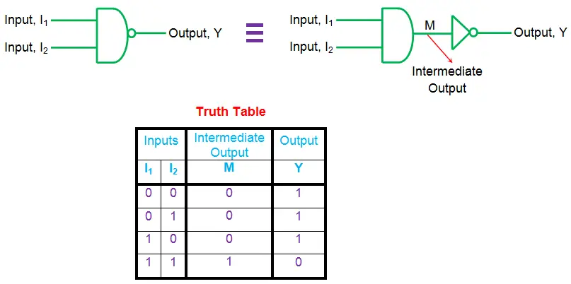

Slide 19
Applications of Truth Table
Some applications of truth tables are listed below.
The most important use of truth table is in logic design of digital circuits. It is used for the design and validation of various logical expressions and then for optimization of digital circuits.
Truth table is also used in computer programming, it is used to design and analyze the logical behavior of algorithms. It plays an important role in the use of bitwise operators.
In communication systems, it is used for error detection. Logical conditions are analyzed to identify and correct the codes with the help of a truth table.
In mathematics, truth tables are used in set theory for an understanding of the relationship between sets using logical operations and it is also used to simplify logical expressions in predicate logic.

Slide 20
Advantages of Truth Table
Some advantages of the truth table are listed below.
The truth table provides clean representation which makes it easier to analyze.
It provides a systematic method for analyzing all possible combinations of truth values of a particular logical expression.
It is very easy to implement.
It helps to find the various outcomes of different logical conditions and hence helps in design.
Disadvantages of Truth Table
Some disadvantages of the truth table are listed below.
As the number of variables increases it also grows in size and becomes very big making it difficult to use.
It provides redundant information sometimes when the logical expression follows a pattern.
It is very time-consuming for big logical expressions as the number of variables is more.
It cannot be used for optimization.
It is highly dependent on expressions, and it is difficult to convert language statements into truth tables.

Slide 21
Timing Diagram
A timing diagram is a graphical representation that focuses on the changing conditions within and among lifelines along a linear time axis. It is a special form of a sequence diagram, where the time dimension is horizontal and increases from left to right, while the lifelines are shown in separate compartments arranged vertically.
A timing diagram is basically a graph that accurately displays the relationship of two or more waveforms with respect to each other on a time basis.

Slide 22
What is a Timing Diagram?
A timing diagram is a graphical representation that shows the states (HIGH or LOW) of digital signals as a function of time. Digital circuits operate using discrete signals, where each signal can either be a logical “0” or “1”. Timing diagrams are essential for understanding how these signals interact within a circuit over time.
Axes: The x-axis represents time, while the y-axis represents the state of the signals (either 0 or 1).
Signal Representation: Since digital signals alternate between “0” and “1”, the timing diagram consists of square pulses corresponding to changes in signal states.
Usage: Timing diagrams are used to understand the behavior of logic circuits, verify designs, and ensure correct synchronization of signals.
Timing diagrams can be generated using oscilloscopes, logic analyzers, or computer-aided design (CAD) tools.

Slide 23
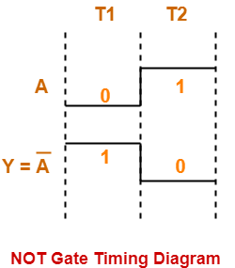
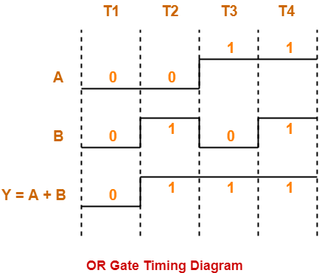
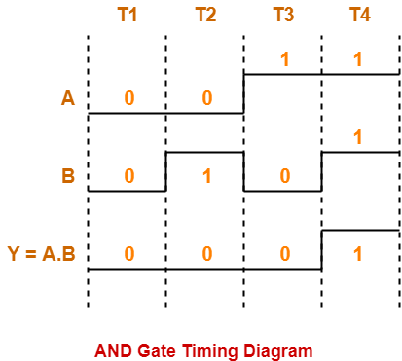

Slide 24
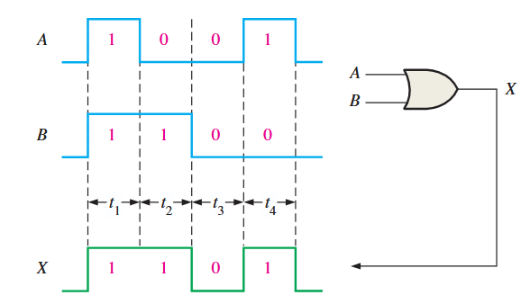
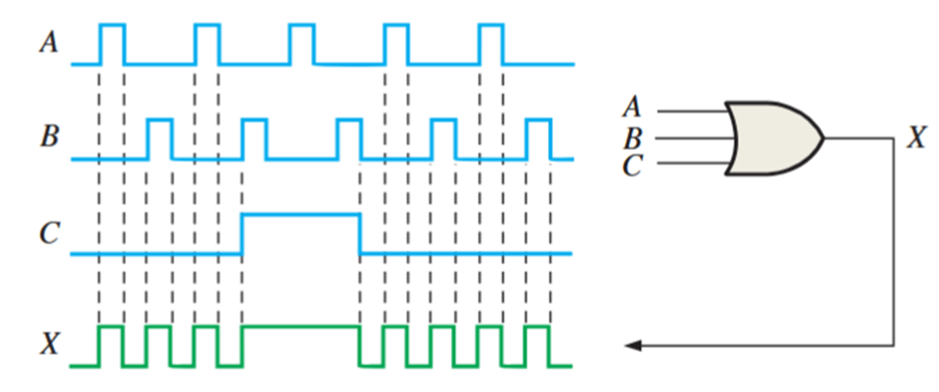

Slide 25
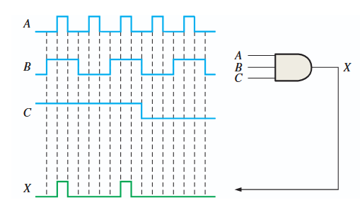
Multisim software

Slide 26
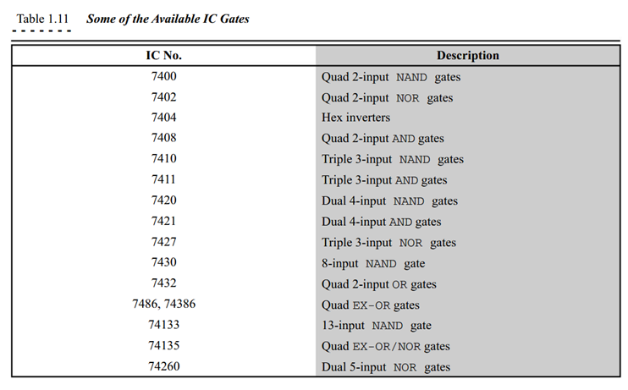

Slide 27
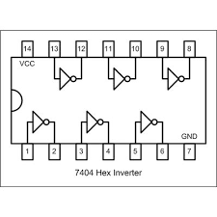
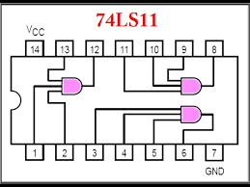
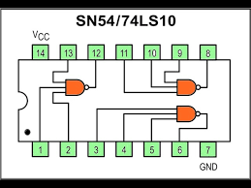
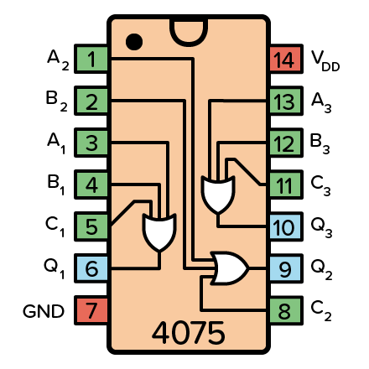
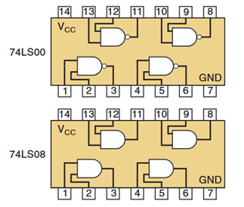
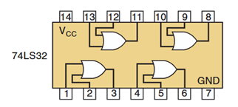
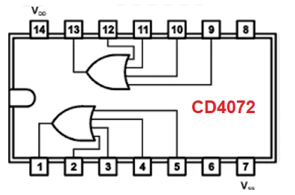
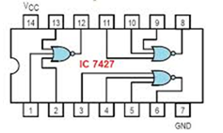
Pin diagram of Digital IC

Slide 28
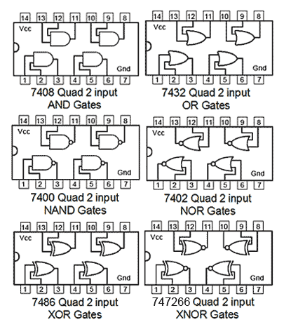

Slide 29
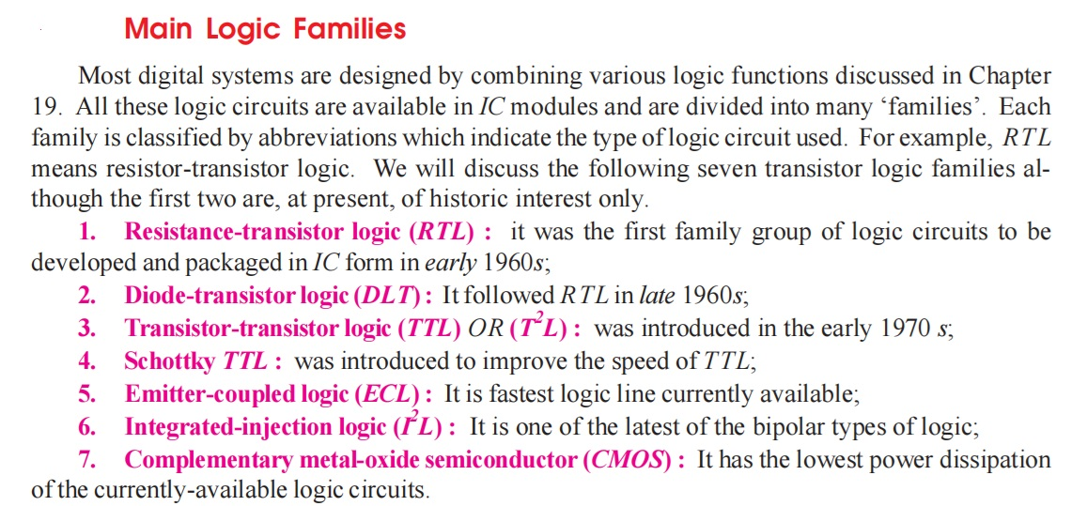

Slide 30
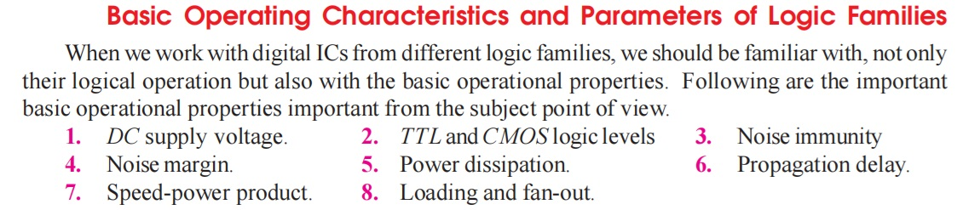
Page-2610

Slide 31
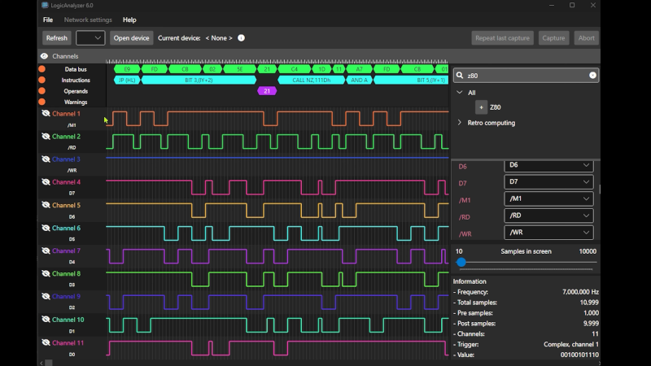
Logic Analyzer

Slide 32
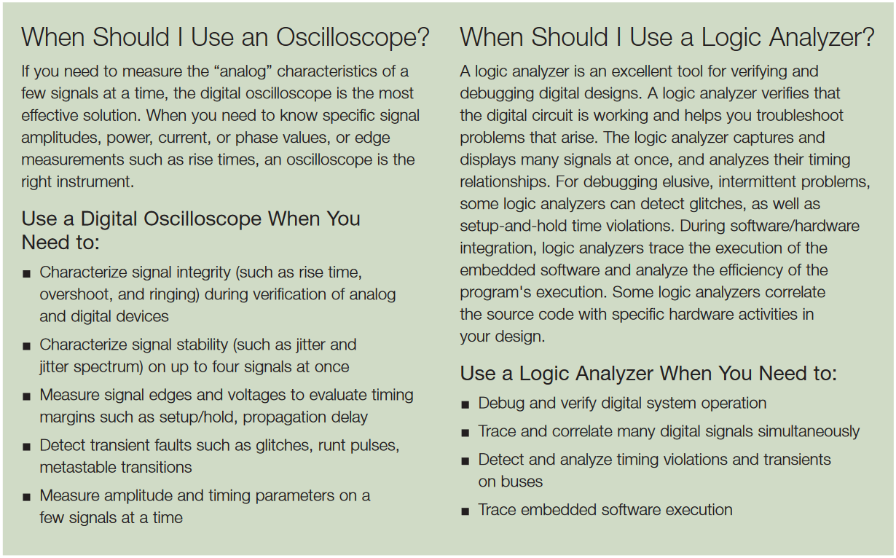


Slide 33
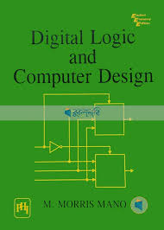
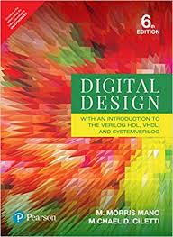
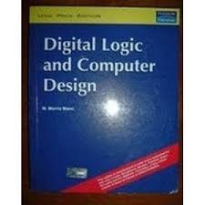
Reference books

Slide 34
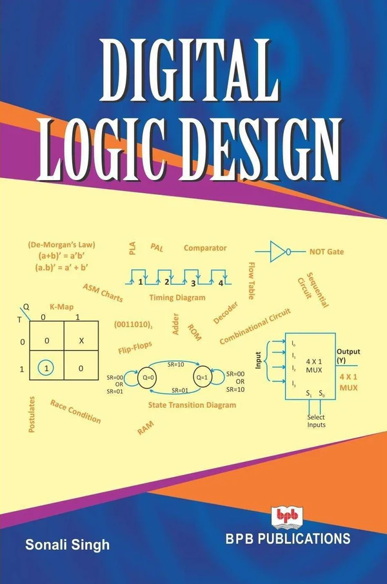
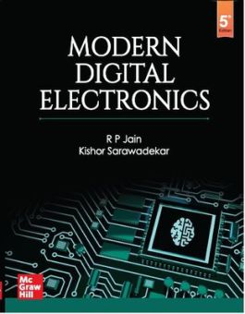
Page-139, OBC
MDS Diagrams | CircuitVerse
CircuitVerse - Digital Circuit Simulator online

Slide 35
Thank You
Q & A
☺

