Slide 1

07142105; Digital Logic Design
Presented by
Professor Mst. Jannatul Ferdous, PhD
Dept. of Computer Science & Engineering
Jatiya Kabi Kazi Nazrul Islam University, Trishal, Mymensingh-2224, Bangladesh.
29th July, 2026

Slide 2
Course Contents
Boolean algebra, De Morgan’s Theorems, logic gates and their trust tables, canonical forms, combination logic circuits, minimization techniques; Arithmetic and data handling logic circuits, decoders and encoders, multiplexers and de-multiplexers; Combinational circuit design; Flip-flops, race around problems; Counters asynchronous counters, synchronous counters and their applications; Reliable Design and Fault Detection; PLA design; Synchronous and asynchronous logic design; State diagram, Mealy and Moore machines; State minimizations and assignments; State Recognizer and Transition Graphs; Pulse mode logic; Fundamental mode design.

Slide 3
Digital Logic Design
Digital logic design is a system in electrical and computer engineering that uses simple number values to produce input and output operations. As a digital design engineer, you may assist in developing cell phones, computers, and related personal electronic devices.
Digital logic design is the basis of electronic systems, such as computers and cell phones. Digital logic is rooted in binary code, which renders information through zeroes and ones, giving each number in the binary code an opposite value. This system facilitates the design of electronic circuits that convey information, including logic gates with functions that include AND, OR, and NOT commands. The value system translates input signals into specific outputs. These functions facilitate computing, robotics, and other electronic applications.

Slide 4
Applications
Digital logic design forms the foundation of electrical engineering and computer engineering. Digital logic designers build complex electronic components that use both electrical and computational characteristics such as power, current, logical function, protocol, and user input. Digital logic design is used to develop hardware, such as circuit boards and microchip processors. This hardware processes user input, system protocol, and other data in navigational systems, cell phones, or other high-tech systems.

Slide 5
Logic design involves creating systems that perform specific functions using logical operations like AND, OR, and NOT gates.
digital logic design meaning refers to the study and application of logic gates and circuits that process binary data. That is, the zeros and ones that form the language of computers. This area focuses on designing hardware systems that can execute logical operations, store data, and perform calculations.
It is called “digital” because the data being processed is discrete (0 or 1), as opposed to continuous signals in analogue systems. Engineers use this framework to create everything from microprocessors to memory chips.

Slide 6
we need to look at its building blocks:
Logic Gates: AND, OR, NOT, NAND, NOR, XOR which are the fundamental units that perform logical functions.
Combinational Circuits: Circuits where output depends solely on the current input (e.g., adders, multiplexers).
Sequential Circuits: Circuits that depend on both input and previous states, making memory and storage possible (e.g., flip-flops, registers).
Binary Arithmetic: Operations such as addition, subtraction, multiplication, and division carried out using digital circuits.
Together, these components allow computers to carry out complex operations with precision and speed.

Slide 7
Real-world examples of digital logic design
The digital logic design meaning becomes clearer when viewed through practical examples:
Microprocessors: The “brains” of computers rely entirely on digital logic to execute instructions.
Digital Clocks: Use sequential circuits to count seconds, minutes, and hours.
Memory Units: RAM and ROM are based on digital circuits that store and retrieve information.
Traffic Light Controllers: Operate using logic circuits programmed to manage sequences and timing.
Smartphones: Every app, call, or photo relies on layers of digital logic embedded in processors and memory.

Slide 8
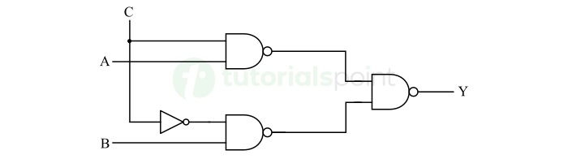
Design and Construction of Digital Circuits
The digital electronic circuits are made up of tiny electronic components called logic gates. Where, logic gates are electronic circuits that can perform a Boolean or logical function on input signals. The main component of logic gates is transistor that acts as a switching device.
An example of digital electronic circuit is shown in the following figure.

Slide 9
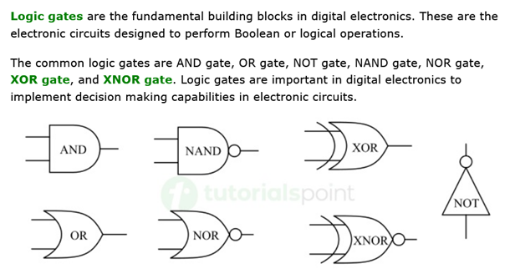
Logic gate
https://www.tutorialspoint.com/digital-electronics/index.htm

Slide 10
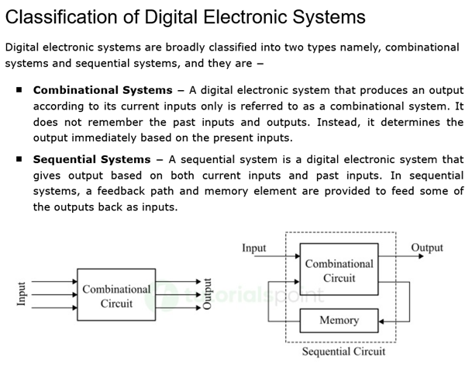

Slide 11
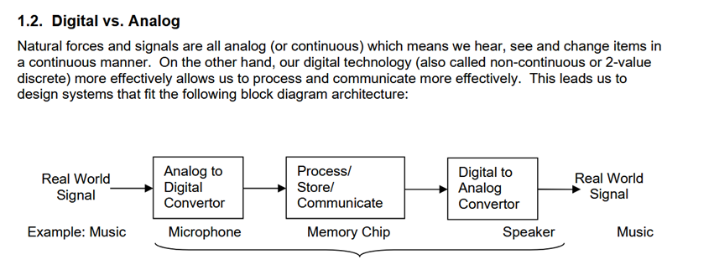

Slide 12
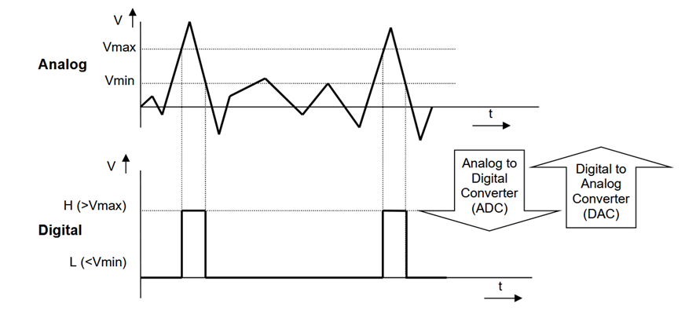

Slide 13
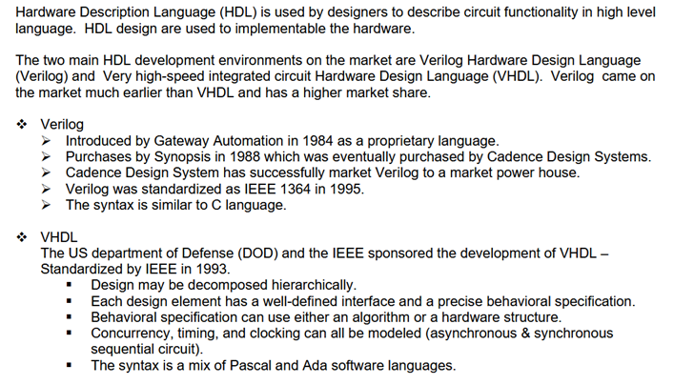

Slide 14
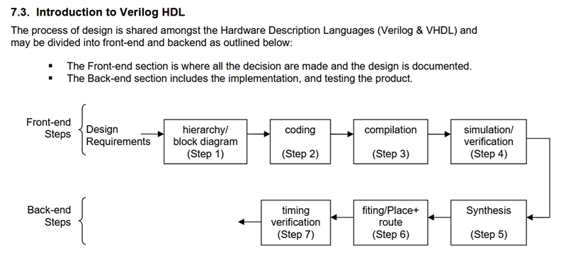

Slide 15
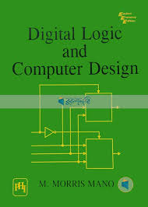
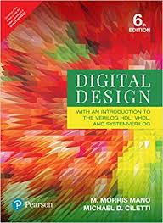
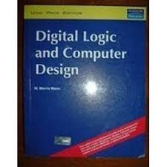
Reference books

Slide 16
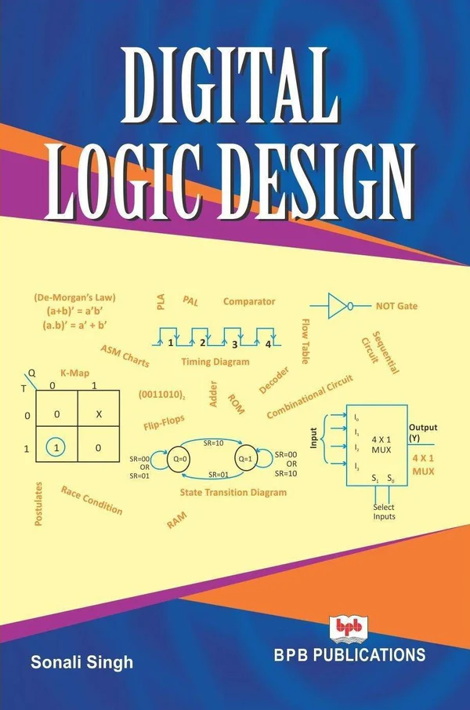
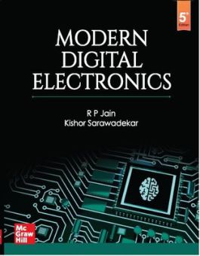
Page-139, OBC
MDS Diagrams | CircuitVerse
CircuitVerse - Digital Circuit Simulator online

Slide 17
Thank You
Q & A
☺

