Slide 1
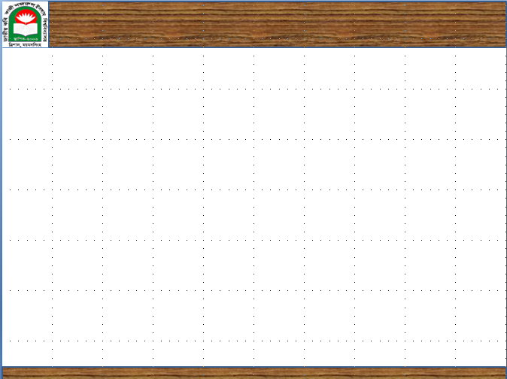
CSE 201: Data Structure
Start Up
Course Teacher: Dr. A. H. M. Kamal
To Session: 2016-17
Year : 2 Semester: 1
Date of class commencement: 22/02/2018 Class termination: 31/05/2018
Evaluation method:
Early evaluation
Mid Term I 10
Mid Term II 10
Mid Term III (A project) 10
Class attendance 10
Early evaluation total 40
Final exam 60
Total 100

Slide 2
CSE 201: Data Structure
Start Up
Course Teacher: Dr. A. H. M. Kamal
To Session: 2016-17
Year : 2 Semester: 1
Date of class commencement: 22/02/2018 Class termination: 31/05/2018
One Mid Term will be boosted up. How?
Let the mark of a Mid Term is M.
Let L=log10(M)*10
Let Integer_of_L=ceiling(L,1)
Boosted_UP=max(M, Integer_of_L)

Slide 3
CSE 201: Data Structure
Start Up
Course Teacher: Dr. A. H. M. Kamal
To Session: 2016-17
Year : 2 Semester: 1
Date of class commencement: 22/02/2018 Class termination: 31/05/2018
What about the project?
You will be assigned a work to perform one of the following:
to design a game
to solve a mathematical problem
to develop an educational apps
any thing you can propose relating the theme of the course

Slide 4
CSE 201: Data Structure
Start Up
Course Teacher: Dr. A. H. M. Kamal
To Session: 2016-17
Year : 2 Semester: 1
Date of class commencement: 22/02/2018 Class termination: 31/05/2018
Another padding course, CSE 202: Data structure lab
Total class 14
Evaluation during class:
Have to submit one report 10
Attendance 10
Early evaluation 20
Final Evaluation:
Viva 30
Script writing 15
Experiment 35
Final evaluation Total 80
-------------------------------------------------------------------------------------------------------------
Total 100

Slide 5
CSE 201: Data Structure
Start Up
Academic Offences
Academic Offences include, but are not limited to:
Infringing unreasonably on the work of other members
E.g., disrupting classes
Cheating
Plagiarism
Misrepresentations
Copying from unauthorized documents or from side person(s) during the examination

Slide 6
CSE 201: Data Structure
Start Up
Plagiarism
All projects must be done individually:
You may not copy code directly from any other source
If you viewed another code (from books or lecture notes), you must include a reference in your project
You may not share code with any other students by transmitting completed functions to your peers
This restriction includes—but is not limited to—electronic and hard-copy sharing
You may discuss projects together and help another student debug his or her code; however, you cannot dictate or give the exact solution

Slide 7
CSE 201: Data Structure
Start Up
Plagiarism
Collaboration with other students must be limited to
Discussions
High-level pseudocode
Assistance with debugging (only through the offering of advice)
Sharing test files
All such collaborations must be documented in your source code

Slide 8
CSE 201: Data Structure
Start Up
Plagiarism
When one student copies from another student, both students are responsible
Exceptions are made for outright theft
The penalty for plagiarism on a Project is a mark of 0 on the project in question

Slide 9
CSE 201: Data Structure
Start Up
Plagiarism
One student cannot accept “full responsibility”
For example, A, B, and C worked together sharing the ideas of each other (Good)
They each did their own work, however, they shared code to comment on each others programming (may create problem).
B gave A’s code to D who copied it for his project and submitted it
A and D received a 0.

Slide 10
CSE 201: Data Structure
Start Up
Covered Topics
Fundamentals
Mathematical Background
Array
Link List
Stack
Queue
Tree
Graph
Basic Algorithms

Slide 11
CSE 201: Data Structure
Start Up
Referred Books
Data structure
- By Shaums Outline

